Slide 1
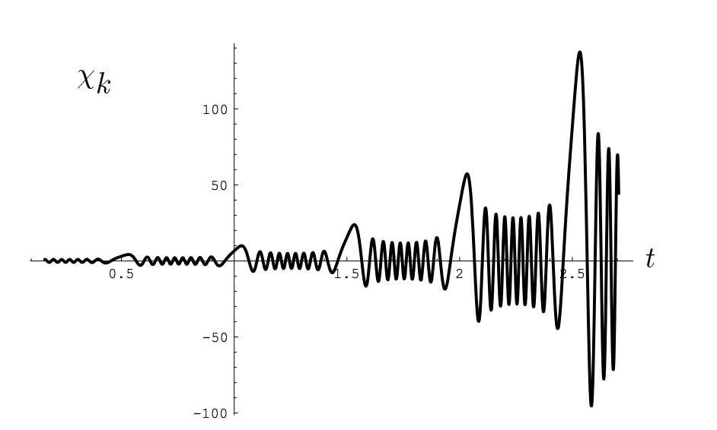
Scalar-graviton interconversion via parametric resonance
Chunshan Lin
Jagiellonian University
Scalar, 2023
University of Warsaw

Slide 2
Part I: parametric resonance

Slide 3
What’s parametric resonance?

Slide 4
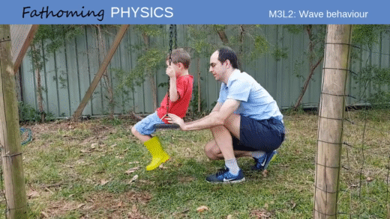
A simple demonstration of the resonance
without resonance
with resonance
Notes:
Resonance describes the phenomenon of increased amplitude that occurs when the frequency of a periodically applied force (or a Fourier component of it) is equal or close to a natural frequency of the system on which it acts. Pushing a person in a swing is a common example of resonance.

Slide 5
A simple demonstration of parametric resonance
Vertically forced pendulum

Slide 6
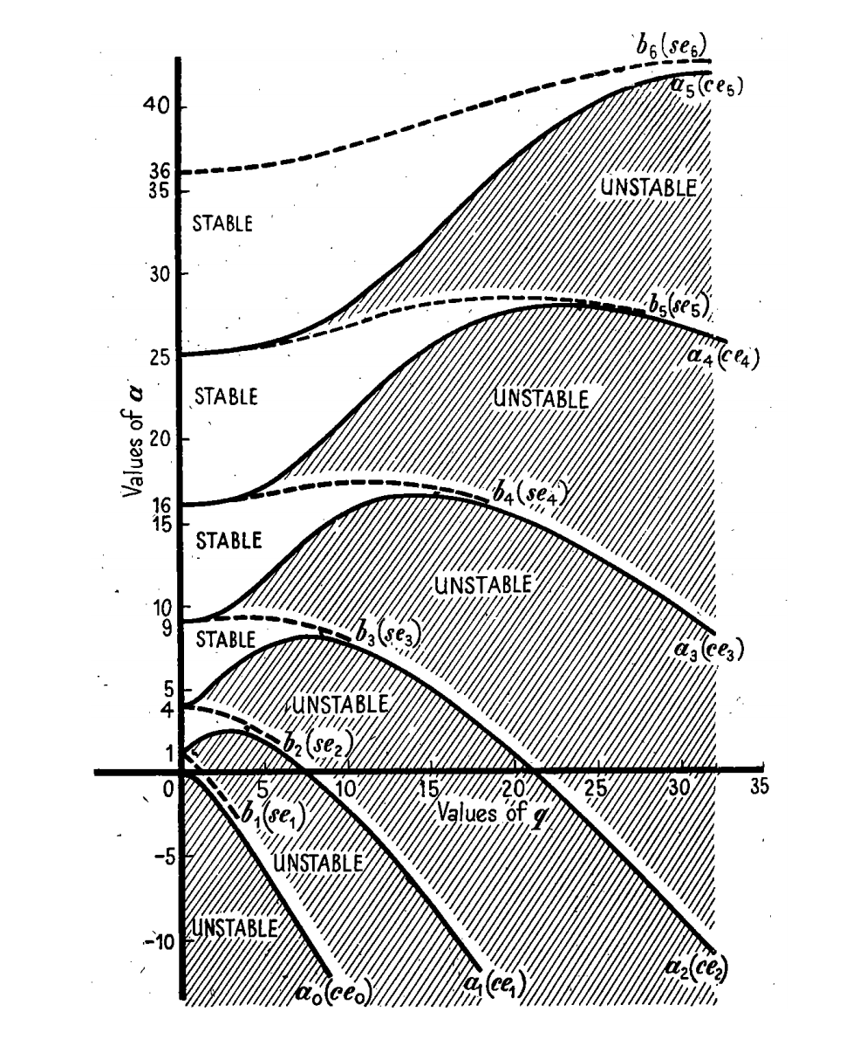
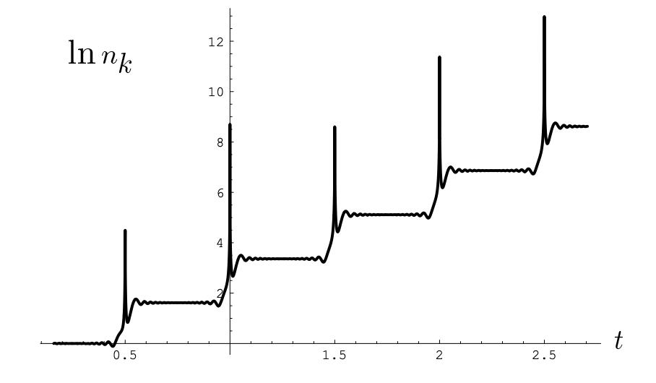
$$A$$
Parametric resoance & Matheiu equation
q
Exponential growth!
Notes:
This effect is different from regular resonance because it exhibits the instability phenomenon.
Parametric resonance occurs in a mechanical system when a system is parametrically excited and oscillates at one of its resonant frequencies. Parametric resonance takes place when the external excitation frequency equals twice the natural frequency of the system. In a Parametric excitated system, the action appears as a time varying modification on a system parameter.
For small amplitudes and by linearising, the stability of the periodic solution is given by Mathieu's equation:

Slide 7
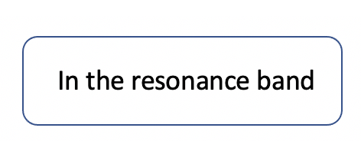
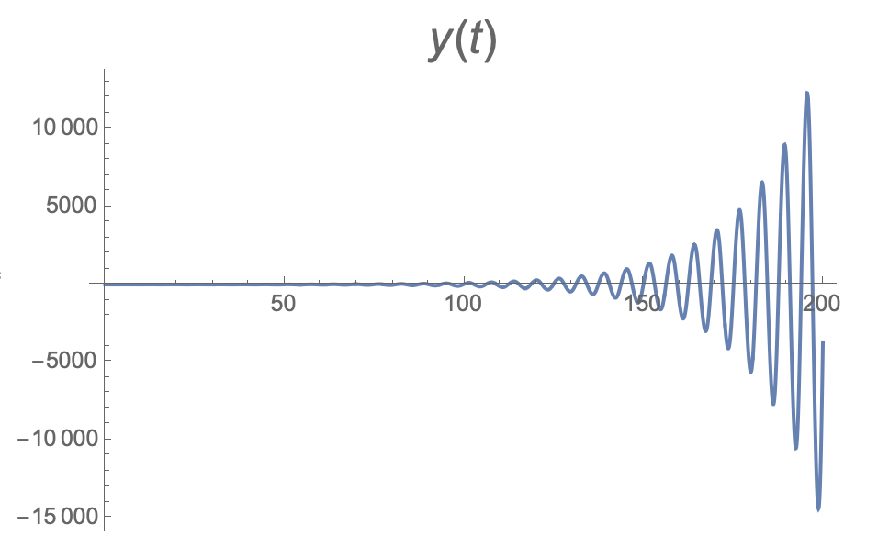
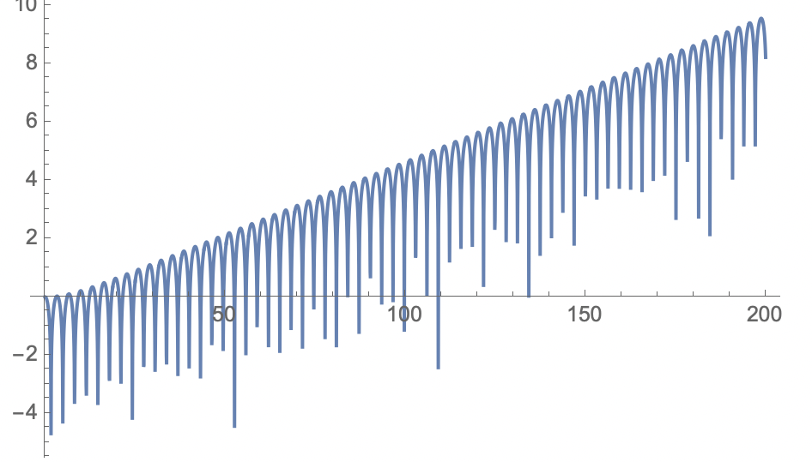
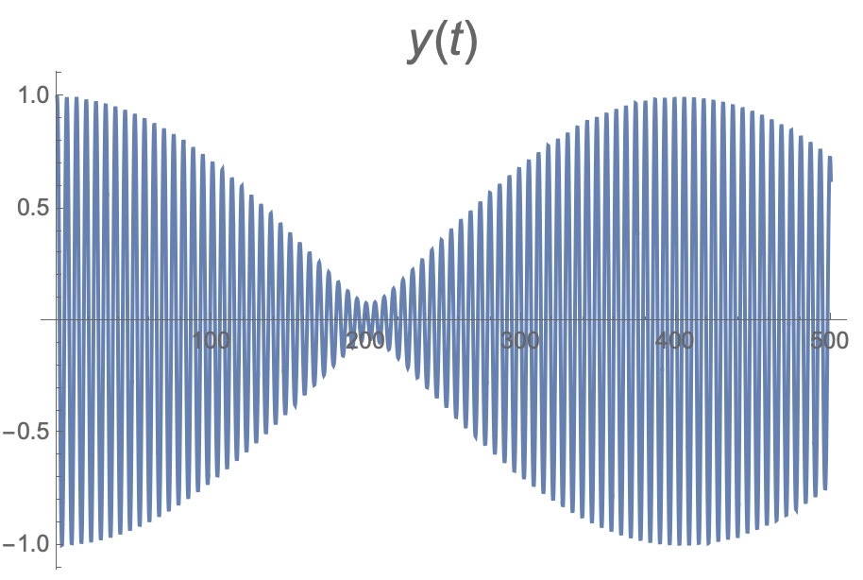
Off the band

Slide 8
A classical application in cosmology: reheating

Slide 9
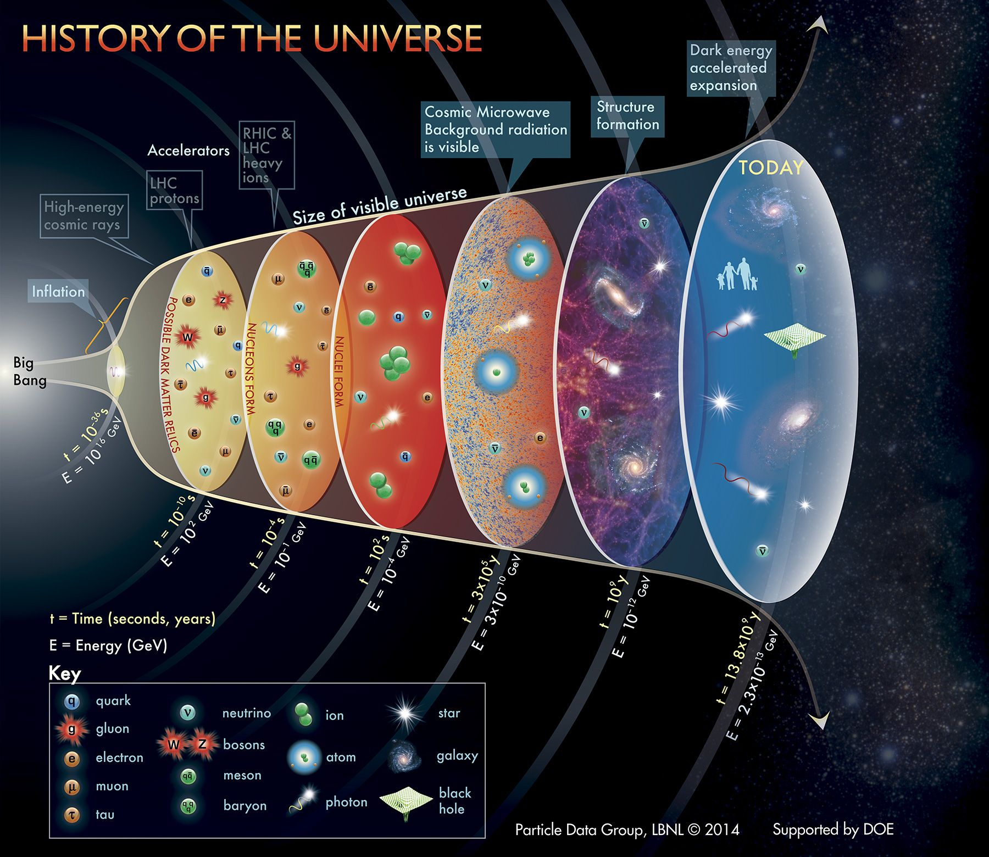
2 landmarks
Big Bang nucleosynthesis (BBN)
Age of universe 1 s
Temperature -- few MeV
CMB formation
Age of universe 370,000 years
Temperature around 4000 K
and a fairly tale
The largest free lunch in this world
-- the beginning of the big bang
BBN
CMB
fairly tale
the big bang!
Notes:
We know that our universe started from a big bang. Our baby universe was hot dense and structureless. It cools down as the universe expands, and structure also started to grow at some point when the universe was cool enough. It is believed that the beginning of the big bang is an inflation phase.

Slide 10
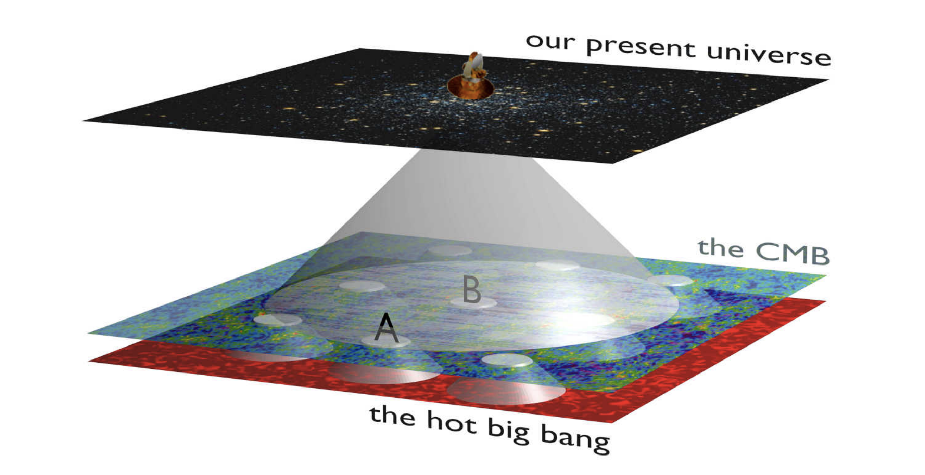
time
The moment when CMB formed
Why is the CMB so homogeneous?
The horizon problem of the hot big bang

Slide 11
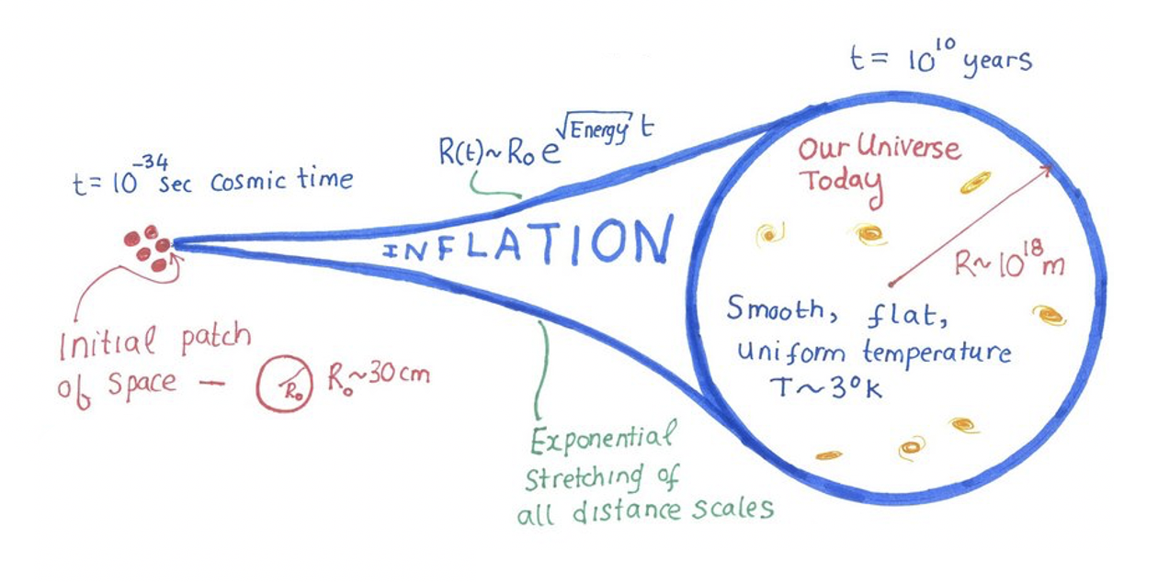
The largest free lunch
$$M= ρ V$$
Inflation
?
Big Bang nucleosynthesis
Dominated by vacuum energy
Energy scale ${10}^{16}$ GeV
Supercooled
Age of universe ${10}^{−36}$s
Populated with SM elements
Temperature -- few MeV
Hot, dense
Age of universe 1 s

Slide 13
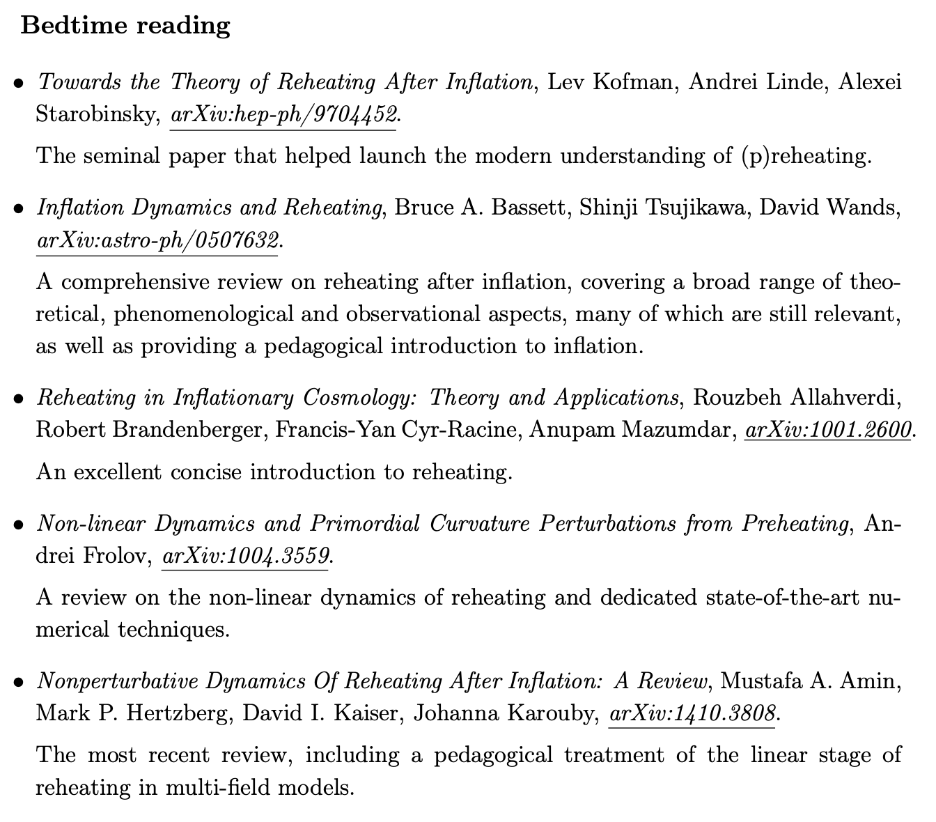

Slide 14
Part II:
Gravitational waves

Slide 15
General relativity 1915;
Gravitational waves 1916;
Together with a young collaborator, I arrived at the interesting result that gravitational waves do not exist…
----1936, A. Einstein to M. Born
Even Einstein himself had hard time to accept it
Notes:
The existence of GWs is a crazy idea, even Einstein has hard time to accept it. A few months after Einstein discovered the general covariant field equation of gravitation, he realised the existence of GWs solution to the Einstein equation. However, he had hard time to convince himself with his original discovery in the next few decades. From time to time he has written some papers to refute his original discovery. For instance, in 1936....

Slide 16
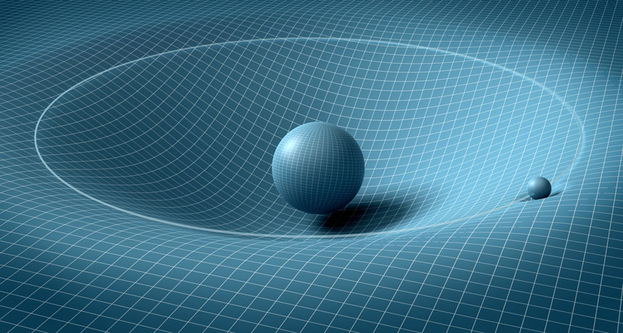
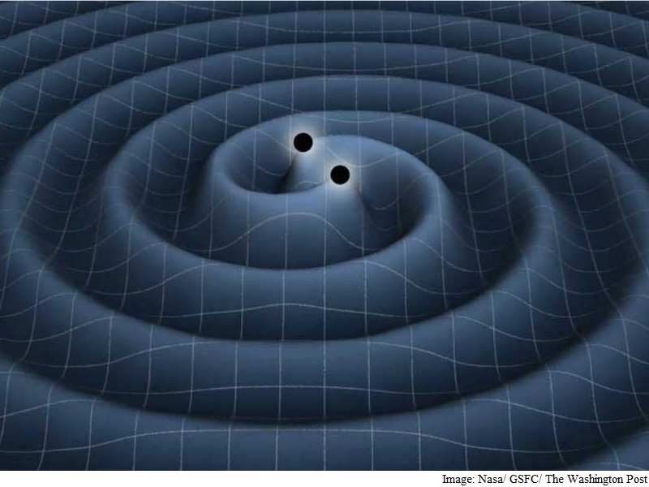
What are the gravitational waves ?
Space-time tells matter how to move; matter tells space-time how to curve.
------ John Wheeler
Notes:
so, what are exactually the GWs?
1, Einstein's revolutionary theory of gravitation, in which the gravitation is regarded as the space-time curvature, while matter moves along the geodesic line in it.This picture reveal the deep connection between gravity and geometry. According the the famous quote by J. Wheeler, here comes the quote"...." Whille 2 massive objects, e.g. BHs orbit around each other, the ripples on the geometrical space-time manifold are constantly generated, and propagtes to the distant.

Slide 17
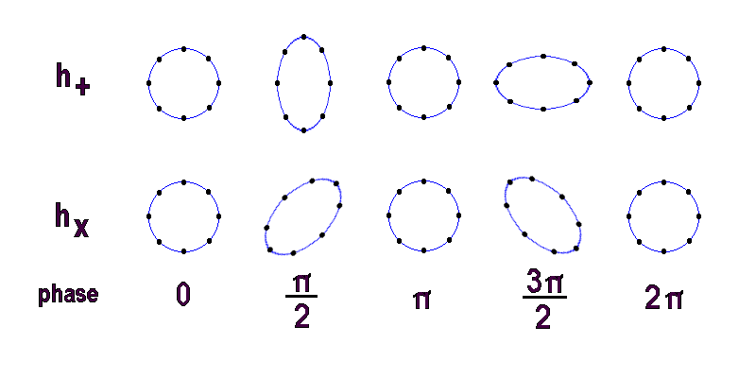
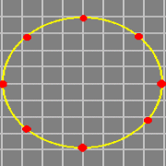
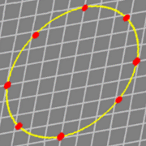
What are the gravitational waves ?
Notes:
when you are facing a GW propagating toward you, the space is squized and streched by 2 different manners, which corresponds to 2 modes of GWs polarisations. 1 SSed along the horizon and vertical direction; 2 SSed off the horizon and vertical direction by 45 degrees..

Slide 18
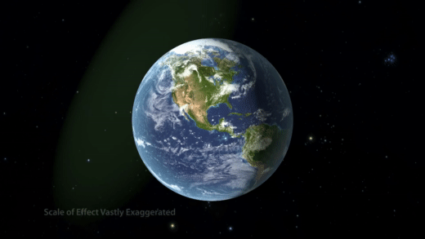
International warning symbol for gravitational radiation.
-- -- credit: T. Moore
When gravitational waves pass by the earth…
Notes:
the earth is like a shaking jelly...

Slide 19
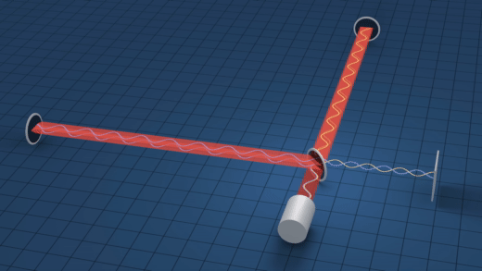
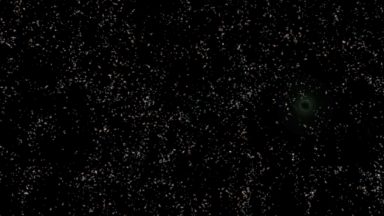
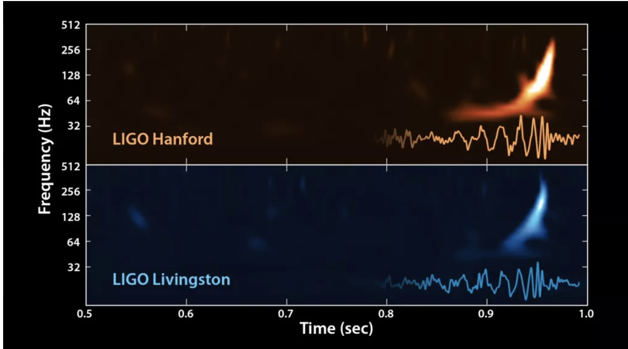
First detection of gravitational waves
---- GW20150914
LIGO
collaboration
Notes:
LIGOThe primary interferometer consists of two laser beams of 4 km length. When a gravitational wave passes through the interferometer, the spacetime in the local area is altered and thus the mirrors are moved by GWs, which eventually caused the interfering of 2 laser beams. This results in a measurable signal.
LIGO is the most sensitive machine we have ever built, it can detect the vibration scale down to the sub-nuclear scale. How to screen out noise? they built 2 detectors...

Slide 20
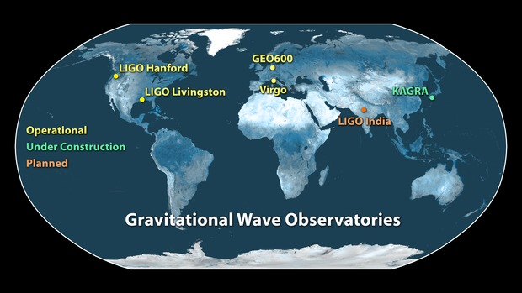
Ground based gravitational wave detector network
22 events
detected
so far, by
LIGO&Virgo

Slide 21
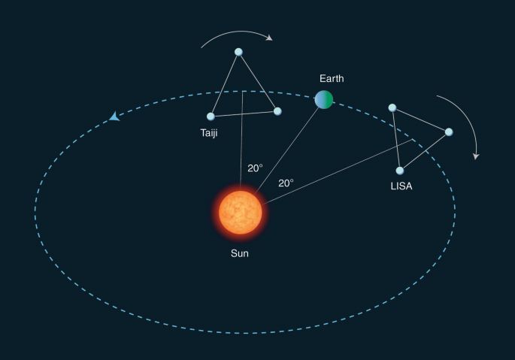
Space-based missions
LISA-Taiji network
Expected to launch in 2034

Slide 22
Part III:
Graviton-to-scalar conversion

Slide 23
Harmonic oscillation induced by a GW
Parametric resonance?
Notes:
when you are facing a GW propagating toward you, the space is squized and streched by 2 different manners, which corresponds to 2 modes of GWs polarisations. 1 SSed along the horizon and vertical direction; 2 SSed off the horizon and vertical direction by 45 degrees..

Slide 24
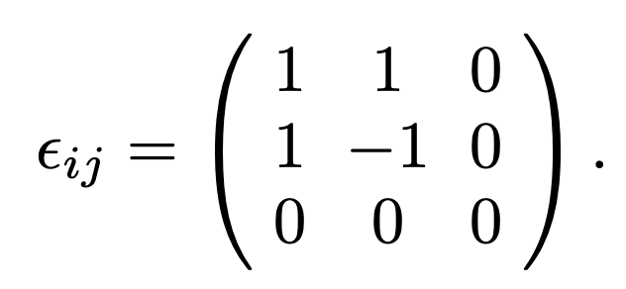
Graviton to Photon Conversion via Parametric Resonance
R. Brandenberger, P. Delgado, A. Ganz, C. Lin, arXiv:2205.08767
Klein-Gordon equation
Fourier transformation
Let’s define
For the mode where
a Mathieu equation!

Slide 25
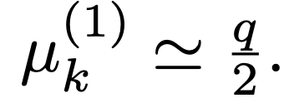
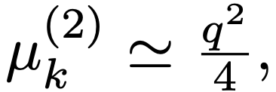
The Klein-Gordon equation is actually a Mathieu equation!
$$A_{k}$$
2nd band in vaccum
Resonance
1st band in medium
q

Slide 26
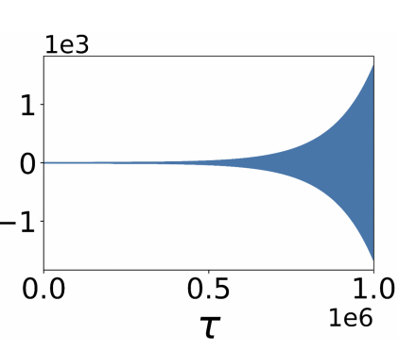
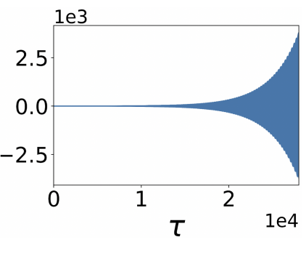
Light + GWs in medium
Weyl gaue $A_{0}=0,$
the Maxwell eqs
fied strength
fied strength
Vacuum $c_{s}=1$
Resonance 2nd band
Water $c_{s}=1$/1.333
Resonance 1st band
Early universe
Astrophysics
Novel GW detector
The Maxwell equation is also a Mathieu equation!

Slide 27
Part IV:
Scalar-to-graviton conversion
or
How to generate gravitational waves in a lab?

Slide 28
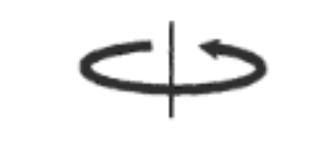
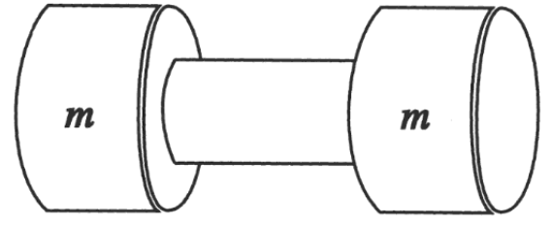
a lab version of the binary star system
2 masses, 1 tone each
1 kHz
How large is the GW ?

Slide 29
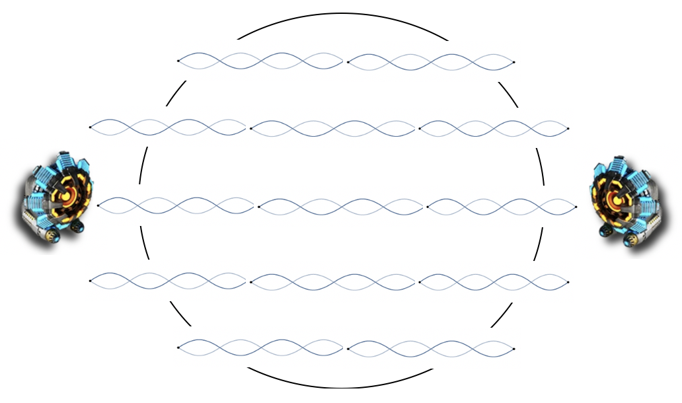
$$z$$
S. Akama, P. Delgado, C. Lin, in preparation
Standing waves
Einstein Equation is also a Mathieu equation!
GWs grow exponentially!
at MeV, $τ_{∗}\sim$ few sec

Slide 30
Conclusion & Homework
Parametric resonance
Graviton-matter conversion
Matter-graviton conversion
homework

Slide 31
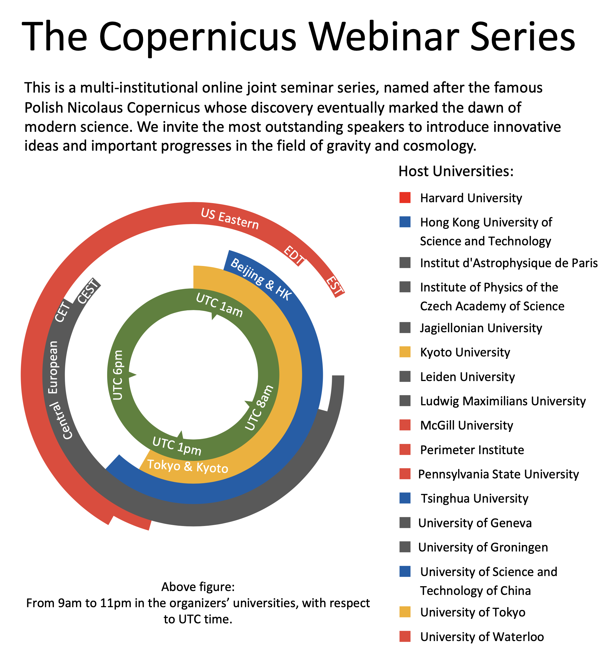
Multi-instituional joint seminar series, launched in 2020
18 universities around the globe
143 seminars held, ongoing
21 colloquiua held, ongoing
Our past speakers:
R. Penrose, E. Witten, S. Yau ...
http://copernicuswebinar.com/
Contact: chunshan.lin@uj.edu.pl

