Slide 1
Influence of interactions on particle production induced by time-varying mass terms
[JHEP 1503 (2015) 113 (arXiv:1412.7442 [hep-ph])]
Seishi Enomoto (Univ. of Warsaw)
Collaborators : Olga Fuksińska and Zygmunt Lalak (UW)
Outline
Introduction
Bogoliubov transformation law with interaction terms
Application to our model
Summary
Notes:
Here is outline.
First of all, I’ll explain about this particle production effect, briefly.
Next I’ll mention about our study,
and finally, I’ll summarize.
OK, let’s move to introduction.

Slide 2
1. Introduction
potential
))
))
Particle production from vacuum
It is known that a varying background causes production of particles
Oscillating Electric field → pair production of electrons
[E. Brezin and C. Itzykson, Phys. Rev. D 2,1191 (1970)]
Changing metric → gravitational particle production
[L. Parker, Phys. Rev. 183, 1057 (1969)]
[L. H. Ford, Phys. Rev. D 35, 2955 (1987)]
Oscillating inflaton → (p)reheating
[L. Kofman, A. D. Linde, A. A. Starobinsky, Phys. Rev. Lett. 73, 3195 (1994)]
[L. Kofman, A. D. Linde, A. A. Starobinsky, Phys. Rev. D 56, 3258 (1997)]
background
Notes:
Now, it is known that particle production from vacuum happens if a background is changing.

Slide 3
Example of scalar particle production (overview)
[L.Kofman, A.Linde, X.Liu, A.Maloney, L.McAllister, E.Silverstein, JHEP 0405, 030 (2004)]
Let us consider : $ℒ_{int}=−\frac{1}{2}g^{2}{\left|φ\right|}^{2}χ^{2}$
If $φ$ goes near the origin…
→ mass of $χ$ ($m_{χ}=gφ$) becomes small around $\left|φ\right|=0$
→ kinetic energy of $φ$ converts to $χ$
★ $χ$ particles are produced !!
$χ$ : real scalar particle (quantum)
$g$ : coupling
$φ$ : complex scalar field (classical)
$$\left|m_{χ}\right|=g\left|φ\right|$$
$$n_{χ}⋅g\left|φ\right|∼$$
$$χ$$
$$χ$$
$$ρ_{χ}$$
$$χ$$
$$t$$
ENERGY
$$φ$$
$$Im φ$$
$$Re φ$$
(massless point)

Slide 4
Equations of motion for $χ$:
$0=\left(∂^{2}+g^{2}{\left|φ\right|}^{2}\right)χ$
$$χ=\int{\frac{d^{3}k}{{\left(2π\right)}^{3}}e^{ik∙x}\left(χ_{k}(t)a_{k}+χ_{k}^{∗}(t)a_{−k}^{†}\right)}$$
If $χ_{k}^{in}$ is a solution, a linear combination $χ_{k}^{in}$ and $χ_{k}^{in∗}$ is also a solution
*Assumption :
$φ=φ(t)$
plane wave
expansion:
plane wave
creation/annihilation op.
time-dependent wave func.
$0={∂_{0}^{2}χ}_{k}+ω_{k}^{2}(t)χ_{k}$ , $\left(χ_{k}, χ_{k}\right)=1$
$ω_{k}≡\sqrt{k^{2}+g^{2}{\left|φ\right|}^{2}}$ , $\left(A,B\right)≡i\left(A^{†}\dot{B}−{\dot{A}}^{†}B\right)$
$$χ_{k}^{out}=α_{k}^{∗}χ_{k}^{in}−β_{k}^{∗}χ_{k}^{in∗}$$
$$\left({\left|α_{k}\right|}^{2}−{\left|β_{k}\right|}^{2}=1\right)$$
$χ_{k}^{in}$ : $i∂_{0}χ_{k}^{in}∼+ω_{k}χ_{k}^{in}$ @ $t=−∞$
$χ_{k}^{out}$ : $i∂_{0}χ_{k}^{out}∼+ω_{k}χ_{k}^{out}$ @ $t=+∞$

Slide 5
Transformation law for operators
$χ=\int{\frac{d^{3}k}{{\left(2π\right)}^{3}}e^{ik∙x}\left(χ_{k}^{out}a_{k}^{out}+χ_{k}^{out∗}a_{−k}^{out†}\right)}$
$=\int{\frac{d^{3}k}{{\left(2π\right)}^{3}}e^{ik∙x}\left(χ_{k}^{in}\left(α_{k}^{∗}a_{k}^{out}−β_{k}^{}a_{−k}^{out†}\right)+χ_{k}^{in∗}\left(−β_{k}^{∗}a_{k}^{out}+α_{k}^{}a_{−k}^{out†}\right)\right)}$
Transformation law (Bogoliubov transformation)
Produced number (occupation number)
$$n_{k}≡\left\langle 0^{in} | a_{k}^{out†}a_{k}^{out} | 0^{in}\right\rangle =V⋅{\left|β_{k}^{}\right|}^{2}$$
With WKB method
$${\left|β_{k}^{}\right|}^{2}∼\exp\left[2 Im ∫dt ω\left(t\right)\right]=\exp\left[−π\frac{k^{2}+g^{2}μ^{2}}{gv}\right]$$
$$χ_{k}^{out}=α_{k}^{∗}χ_{k}^{in}−β_{k}^{∗}χ_{k}^{in∗}$$
$$=a_{k}^{in}$$
$$=a_{−k}^{in†}$$
$$χ_{k}^{out}=α_{k}^{∗}χ_{k}^{in}−β_{k}^{∗}χ_{k}^{in∗}, a_{k}^{out}=α_{k}^{}a_{k}^{in}+β_{k}^{}a_{−k}^{in†}$$
$$\left({\left|α_{k}\right|}^{2}−{\left|β_{k}\right|}^{2}=1\right)$$
$$n_{k}/V$$
$$Im φ$$
$$k$$
$$v$$
$$φ(t)$$
$$μ$$
$$Re φ$$

Slide 6
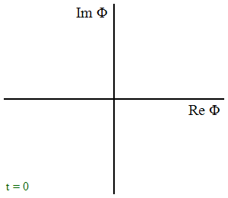
After non-perturbative particle production
$$ℋ={\left|\dot{φ}\right|}^{2}+\frac{1}{2}{\dot{χ}}^{2}+\frac{1}{2}{\left(∇χ\right)}^{2}+\frac{1}{2}g^{2}{\left|φ\right|}^{2}χ^{2}$$
Linear potential is established for $φ$!
$$=ρ_{χ} ∼ n_{χ}⋅g\left|φ\right|$$
$φ$ is trapped around the massless point.
$$V$$
Potential Energy
Initial Kinetic Energy
$$Im φ$$
＝
$χ$ production!
$$v$$
$$μ$$
$$Re φ$$
$χ$ production!

Slide 7
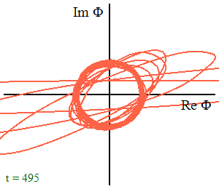
★ Brief summary of introduction
Variable mass (approaching to $φ∼0$)
Particle production ( $χ$ )
produced (occupation) number :
$n_{k}≡\left\langle 0^{in} | a_{k}^{out†}a_{k}^{out} | 0^{in}\right\rangle$
$=V⋅{\left|β_{k}^{}\right|}^{2}∼V⋅e^{−π\frac{k^{2}+g^{2}μ^{2}}{gv}}$
Trapping around massless point ( $φ$ )
$$Im φ$$
$$φ$$
$$Re φ$$
massless point
$$χ$$
$$χ$$
$$Im φ$$
$$φ$$
$$Re φ$$
$$χ$$
$$χ$$
$$χ$$
$$χ$$
$$χ$$
$$Im φ$$
$$φ$$
$$Re φ$$

Slide 8
Our focus
How do (quantum) interaction terms affect particle production?
Usually production rates are calculated in the purely classical background
→ We would like to estimate the contribution of the quantum interaction term
$$φ$$
classical
$$χ$$
classical
classical
quantum
classical
quantum
$$⋯$$
$$⋯$$
quantum
$$ψ$$
quantum
$$A^{μ}$$
Notes:
We want to know not only green effect but also purple effect.

Slide 9
In this talk we consider a simple SUSY model
Superpotential :
$$W=\frac{1}{2}gΦX^{2}$$
→ Interaction terms in components :
$ℒ_{int}=−g^{2}{\left|φ\right|}^{2}{\left|χ\right|}^{2}−\frac{1}{4}g^{2}{\left|χ\right|}^{4}−g\left(\frac{1}{2}φψ_{χ}ψ_{χ}+ψ_{φ}ψ_{χ}χ+(h.c.)\right)$
Stationary point :
$χ=ψ_{φ}=ψ_{χ}=0$ , but $φ$ can have any value
$$Φ=φ+\sqrt{2}θψ_{φ}+θ^{2}F_{φ}$$
$$Χ=χ+\sqrt{2}θψ_{χ}+θ^{2}F_{χ}$$
$g$ : coupling
$$Im φ$$
$$φ\left(t\right)$$
$$Re φ$$
$$φ$$
classical
$$χ$$
massless
Mass $=gφ(t)$
classical
classical
quantum
quantum
Production doesn’t happen…?
Production may happen
$$ψ_{φ}$$
quantum
$$ψ_{χ}$$
Notes:
But later in this talk, I will show that all particles are produced.

Slide 10
2. Bogoliubov transformation law with interaction terms
$$ψ_{φ}$$
$$χ$$
$$ψ_{χ}$$
Our aim:
Evaluation of produced particle number for all species
$$n_{k}\left(t^{out}\right)≡\left\langle 0^{in} | a_{k}^{out†}a_{k}^{out} | 0^{in}\right\rangle$$
To find the Bogoliubov transformation law
in the interacting theory
Method
Schwinger-Keldysh formalism
Yang-Feldman formalism
Others ( but I don’t know… )
$$φ$$
$$a_{k}^{out}⟷a_{k}^{in}$$
Notes:
Since this quantity is in-in state, so maybe the most familiar method is Schwinger-Keldysh formalism.
Next I will explain this with a simple example.

Slide 11
mass,
c-number
An example with a real scalar field $Ψ$ (1/4)
Operator field equation : $0=\left(∂^{2}+M^{2}(x)\right)Ψ(x)+J(x)$
Commutation relation : $\left[Ψ\left(x\right),\dot{Ψ}(y)\right]=iδ^{3}\left(x−y\right)$
→ Formal solution (Yang-Feldman equations)
$$Ψ\left(x\right)=\sqrt{Z}Ψ^{as}\left(x\right)−iZ\int_{y^{0}=t^{as}}^{y^{0}=x^{0}}{d^{4}y}\left[Ψ^{as}\left(x\right),Ψ^{as}\left(y\right)\right] J\left(y\right)$$
$x^{0}=t^{as} ⟹ Ψ\left(x^{as}\right)=\sqrt{Z}Ψ^{as}\left(x^{as}\right)$
If we take $t^{as}=t^{in}=−∞$ or $t^{as}=t^{out}=+∞$,
$$Ψ^{out}\left(x^{out}\right)=Ψ^{in}\left(x^{out}\right)−i\sqrt{Z}\int{d^{4}y}\left[Ψ^{in}\left(x^{out}\right),Ψ^{in}\left(y\right)\right] J\left(y\right)$$
source,
operator
$Z$ : const.
$Ψ^{as}$ : asymptotic field
$$0=\left(∂^{2}+M^{2}\right)Ψ^{as}$$
$$J(y)$$
$$a_{k}^{out}$$
$$a_{k}^{in}$$
$$J(y)$$
x
+
x
$$J(y)$$
$$Ψ^{as}(x)$$
$$J(y)$$
Notes:
In order to explain how to calculate, let’s consider by a simple example, using a scalar case.

Slide 12
An example with a real scalar field $Ψ$ (2/4)
$Ψ^{as}$ is free particle, so we can expand with plane waves as
$$Ψ^{as}\left(x\right)=\int{\frac{d^{3}k}{{\left(2π\right)}^{3}}e^{ik⋅x}\left(Ψ_{k}^{as}(x^{0})a_{k}^{as}+Ψ_{k}^{as∗}\left(x^{0}\right)a_{−k}^{as†}\right)}$$
inner product relation : $\left(Ψ_{k}^{as},Ψ_{k}^{as}\right)=1/Z$
which comes from conditions
$\left[a_{k}^{as}, a_{k^{′}}^{as†}\right]={\left(2π\right)}^{3}δ^{3}\left(k−k^{′}\right)$ , $Z{\left[Ψ^{as}\left(x\right),{\dot{Ψ}}^{as}\left(y\right)\right]}_{t→t^{as}}=iℏδ^{3}\left(x−y\right)$
a projection from $Ψ^{as}$ to $Ψ_{k}^{as}$ direction
plane wave
wave func.
$$0={∂_{0}^{2}Ψ}_{k}^{as}+\left(k^{2}+M^{2}\right)Ψ_{k}^{as}$$
creation/annihilation op.
$$e^{ik⋅x}a_{k}^{as}⋅Ψ_{k}^{as}$$
$$a_{k}^{as}=Z\int{d^{3}x e^{−ik⋅x} \left(Ψ_{k}^{as},Ψ^{as}\right)}$$
$$Ψ^{as}$$
$$Ψ_{k}^{as}$$
$$Ψ_{k}^{as∗}$$

Slide 13
An example with a real scalar field $Ψ$ (3/4)
Relation between $a_{k}^{in}$ and $a_{k}^{out}$
$$a_{k}^{out}=Z\int{d^{3}x e^{−ik⋅x} \left(Ψ_{k}^{out},Ψ^{out}\right)}$$
$$a_{k}^{out}=α_{k}a_{k}^{in}+β_{k}a_{−k}^{in†}−i\sqrt{Z}\int{d^{4}x e^{−ik⋅x}\left(α_{k}Ψ_{k}^{in∗}−β_{k}Ψ_{k}^{in}\right) J(y)}$$
$$Ψ^{out}\left(x^{out}\right)=Ψ^{in}\left(x^{out}\right)−i\sqrt{Z}\int{d^{4}y}\left[Ψ^{in}\left(x^{out}\right),Ψ^{in,∗}\left(y\right)\right] J\left(y\right)$$
(usual) Bogoliubov tfn law
Interaction effects
$$α_{k}≡Z\left(Ψ_{k}^{out},Ψ_{k}^{in}\right)$$
$$β_{k}≡Z\left(Ψ_{k}^{out},Ψ_{k}^{in∗}\right)$$
$$Ψ_{k}^{in}=α_{k}Ψ_{k}^{out}+β_{k}Ψ_{k}^{out∗}$$
$$Ψ_{k}^{out}=α_{k}^{∗}Ψ_{k}^{in}−β_{k}^{∗}Ψ_{k}^{in∗}$$
$${\left|α_{k}\right|}^{2}−{\left|β_{k}\right|}^{2}=1$$

Slide 14
An example with a real scalar field $Ψ$ (4/4)
Produced (occupation) number :
$n_{k}=\left\langle 0^{in} | a_{k}^{out†}a_{k}^{out} | 0^{in}\right\rangle$
$={\left|\left(β_{k}a_{−k}^{in†}−i\sqrt{Z}\int{d^{4}x e^{−ik⋅x}\left(α_{k}Ψ_{k}^{in∗}−β_{k}Ψ_{k}^{in}\right) J }\right)|\left.0^{in}\right\rangle \right|}^{2}$
$=\left\{\begin{aligned} V⋅{\left|β_{k}\right|}^{2} + ⋯ \\ 0 +Z{\left|\int{d^{4}x e^{−ik⋅x} Ψ_{k}^{in∗} J}|\left.0^{in}\right\rangle \right|}^{2}\end{aligned}\right.$
Particles can be produced even if $β_{k}=0$ !
In case of a fermionic field
Inner product becomes
$\left(A,B\right)≡i\left(A^{†}\dot{B}−{\dot{A}}^{†}B\right) ⟹ {\left(A,B\right)}_{F}≡\overline{A}γ^{0}B$ ( $A,B$ : 4-component )
In case of Majorana fermions, the formulae are more complicated
$$β_{k}≠0$$
$$β_{k}=0$$
Notes:
So, even if beta is zero, particle production can be happened due to interaction effect.

Slide 15
★ Brief summary of this section
Bogoliubov transformation law with interaction effects
$$a_{k}^{out}=α_{k}a_{k}^{in}+β_{k}a_{−k}^{in†}−i\sqrt{Z}\int{d^{4}x e^{−ik⋅x}\left(α_{k}Ψ_{k}^{in∗}−β_{k}Ψ_{k}^{in}\right) J(y)}$$
Wave functions’ law keeps ordinary form
$$Ψ_{k}^{out}=α_{k}^{∗}Ψ_{k}^{in}−β_{k}^{∗}Ψ_{k}^{in∗}$$
The particle production can happen even if $β_{k}=0$
(usual) Bogoliubov tfn law
Interaction effects

Slide 16
3. Application to our model
Model (again)
$$ℒ_{int}=−g^{2}{\left|φ\right|}^{2}{\left|χ\right|}^{2}−\frac{1}{4}g^{2}{\left|χ\right|}^{4}−g\left(\frac{1}{2}φψ_{χ}ψ_{χ}+ψ_{φ}ψ_{χ}χ+(h.c.)\right)$$
Equation of Motion :
$φ$ : $0=\left(∂^{2}+g^{2}{\left|χ\right|}^{2}\right)φ+\frac{1}{2}gψ_{χ}^{†}ψ_{χ}^{†}$
$χ$ : $0=\left(∂^{2}+g^{2}{\left|φ\right|}^{2}+\frac{1}{2}g^{2}{\left|χ\right|}^{2}\right)χ+gψ_{φ}^{†}ψ_{χ}^{†}$
$ψ_{φ}$ : $0={\overline{σ}}^{μ}∂_{μ}ψ_{φ}+igχ^{†}ψ_{χ}^{†}$
$ψ_{χ}$ : $0={\overline{σ}}^{μ}∂_{μ}ψ_{χ}+igφ^{†}ψ_{χ}^{†}+igχ^{†}ψ_{φ}^{†}$
EOM for asymptotic fields (as = in, out):
$φ^{as}$ : $0=∂^{2}φ^{as}$
$χ^{as}$ : $0=\left(∂^{2}+g^{2}{\left|\left\langle φ\right\rangle \right|}^{2}\right)χ^{as}$
$ψ_{φ}^{as}$ : $0={\overline{σ}}^{μ}∂_{μ}ψ_{φ}^{as}$
$ψ_{χ}^{as}$ : $0={\overline{σ}}^{μ}∂_{μ}ψ_{χ}^{as}+ig\left\langle φ^{†}\right\rangle ψ_{χ}^{as†}$
$φ$ has a backgound
$χ$ , $ψ_{φ}$, $ψ_{χ}$ : no background
*** source terms
$$\left\langle φ\right\rangle ≡\left\langle 0^{in} | φ | 0^{in}\right\rangle$$

Slide 17
Definition of wave functions (Assuming $\left\langle φ\right\rangle =\left\langle φ\left(t\right)\right\rangle$)
$φ^{as}=\left\langle φ^{as}\right\rangle +\int{\frac{d^{3}k}{{\left(2π\right)}^{3}}e^{ik⋅x}\left(φ_{k}^{as}a_{φk}^{+,as}+φ_{k}^{as∗}a_{φ−k}^{−,as†}\right)}$
$0={\ddot{φ}}_{k}^{as}+k^{2}φ_{k}^{as}$ → $φ_{k}^{in}=φ_{k}^{out}∝e^{−ikt}$ → ${\left|β_{φk}^{}\right|}^{2}=0$
$χ^{as}=\int{\frac{d^{3}k}{{\left(2π\right)}^{3}}e^{ik⋅x}\left(χ_{k}^{as}a_{χk}^{as}+χ_{k}^{as∗}b_{χ−k}^{as†}\right)}$
$0={\ddot{χ}}_{k}^{as}+\left(k^{2}+g^{2}{\left|\left\langle φ\right\rangle \right|}^{2}\right)χ_{k}^{as}$ → ${\left|β_{χk}^{}\right|}^{2}≡{\left|Z_{χ}\left(χ_{k}^{out},χ_{k}^{in∗}\right)\right|}^{2}≠0$
$ψ_{φ}^{as}=\int{\frac{d^{3}k}{{\left(2π\right)}^{3}}e^{ik⋅x}\left(e_{k}^{+}ψ_{φk}^{+,as}a_{ψ_{φ}k}^{+as}+e_{k}^{−}ψ_{φk}^{−,as∗}a_{ψ_{φ}−k}^{−as†}\right)}$
$0={\dot{ψ}}_{φk}^{as}+i\left|k\right|ψ_{φk}^{as}$ → $ψ_{φk}^{in}=ψ_{φk}^{out}∝e^{−ikt}$ → ${\left|β_{ψ_{φ}k}^{}\right|}^{2}=0$
$ψ_{χ}^{as}=\sum_{s=±}{\int{\frac{d^{3}k}{{\left(2π\right)}^{3}}e^{ik⋅x}e_{k}^{s}\left(ψ_{χk}^{\left(+\right)s,as}a_{ψ_{χ}k}^{s}−se^{−iθ_{k}}ψ_{χk}^{\left(−\right)s,as∗}a_{ψ_{χ}−k}^{s†}\right)}}$
(* eigen vector for helicity)
(* phase)
$$0={\dot{ψ}}_{χk}^{\left(+\right)s,as}+is\left|k\right|ψ_{χk}^{\left(+\right)s,as}+ig\left\langle φ^{†}\right\rangle ψ_{χk}^{\left(−\right)s,as}$$
$$0={\dot{ψ}}_{χk}^{\left(−\right)s,as}−is\left|k\right|ψ_{χk}^{\left(−\right)s,as}+ig\left\langle φ\right\rangle ψ_{χk}^{\left(+\right)s,as}$$
→ ${\left|β_{ψ_{χ}k}^{s}\right|}^{2}≡{\left|Z_{ψ_{χ}}\left(ψ_{χk}^{\left(+\right)s,out}ψ_{χk}^{\left(−\right)s,in}−ψ_{χk}^{\left(−\right)s,out}ψ_{χk}^{\left(+\right)s,in}\right)\right|}^{2}≠0$

Slide 18
Analytical results (massive particles $χ$, $ψ_{χ}$; $β_{k}^{}≠0$)
$n_{χk}/V≡\left\langle 0^{in} | a_{χk}^{+,out†}a_{χk}^{+,out} | 0^{in}\right\rangle /V+\left\langle 0^{in} | a_{χk}^{−,out†}a_{χk}^{−,out} | 0^{in}\right\rangle /V$
$=2{\left|β_{χk}^{}\right|}^{2}+⋯$
$=2\exp\left[2 Im∫dt \sqrt{k^{2}+g^{2}{\left|\left\langle φ\right\rangle \right|}^{2}}\right]+…$
$=2\exp\left[−π\frac{k^{2}+g^{2}μ^{2}}{gv}\right]+⋯$
$n_{ψ_{χ}k}^{}/V≡\sum_{s}{\left\langle 0^{in} | a_{ψ_{χ}k}^{s,out†}a_{ψ_{χ}k}^{s,out} | 0^{in}\right\rangle }/V$
$=\sum_{s}{{\left|β_{ψ_{χ}k}^{s}\right|}^{2}}+⋯$
$=2\exp\left[−π\frac{k^{2}+g^{2}μ^{2}}{gv}\right]+⋯$

Slide 19
Analytical results (massless particle $\tilde{φ}$; $β_{φk}^{}=0$)
$n_{φk}/V≡\left\langle 0^{in} | {\tilde{a}}_{φk}^{+,out†}{\tilde{a}}_{φk}^{+,out} | 0^{in}\right\rangle /V+\left\langle 0^{in} | {\tilde{a}}_{φk}^{−,out†}{\tilde{a}}_{φk}^{−,out} | 0^{in}\right\rangle /V$
$\left( \tilde{a}≡a−\left\langle 0^{in} | a | 0^{in}\right\rangle \right)$
$⋮$
$=g^{2}\int{\frac{d^{3}p}{{\left(2π\right)}^{3}}\left[Z_{φ}^{}Z_{χ}^{2}\left({\left|\int{dt φ_{k}^{out} χ_{\left|k+p\right|}^{in} χ_{p}^{in}⋅g\left\langle φ\right\rangle }\right|}^{2}\right.\right.}$
$\left.+{\left|\int{dt φ_{k}^{out} χ_{\left|k+p\right|}^{in} χ_{p}^{in}⋅g\left\langle φ^{†}\right\rangle }\right|}^{2}\right)$
$+\frac{1}{4}Z_{φ}^{}Z_{ψ_{χ}}^{2}\sum_{s,r,q}{\left(1+sr\frac{p⋅\left(k+p\right)}{p\left|k+p\right|}\right)}\left.\left.{\left|\int{dt φ_{k}^{out} ψ_{χ\left|k+p\right|}^{\left(q\right)s,in} ψ_{χp}^{\left(q\right)r,in}}\right|}^{2}\right)\right]+⋯$
$=$
$$φ_{}^{out}$$
$$2$$
$$φ_{}^{out}$$
$$2$$
$$k$$
$$\left\langle φ\right\rangle$$
$$k$$
x
$$+$$
$$+$$
anti-particle
diagrams
$$k+p$$
$$p$$
$$k+p$$
$$p$$
$$χ^{in}$$
$$χ^{in}$$
$$ψ_{χ}^{in}$$
$$ψ_{χ}^{in}$$

Slide 20
Analytical results (massless particle $ψ_{φ}$; $β_{ψ_{φ}k}^{}=0$)
$n_{ψ_{φ}k}^{}/V≡\sum_{s}{\left\langle 0^{in} | a_{ψ_{φ}k}^{s,out†}a_{ψ_{φ}k}^{s,out} | 0^{in}\right\rangle }/V$
$⋮$
$=g^{2}\int{\frac{d^{3}p}{{\left(2π\right)}^{3}}Z_{χ}^{}Z_{ψ_{φ}}^{}Z_{ψ_{χ}}^{}\sum_{s,r}{\frac{1}{2}\left(1−sr\frac{p⋅k}{pk}\right)}}$ $×{\left|\int{dt ψ_{φk}^{out} χ_{\left|k+p\right|}^{in} ψ_{χp}^{\left(s\right)r,in}}\right|}^{2}+⋯$
$∼$
★ The main channel of massless particles production is “inverse decay”
$$n_{k}∼Z{\left|\int{d^{4}x e^{−ik⋅x} Ψ_{k}^{in∗} J}|\left.0^{in}\right\rangle \right|}^{2}$$
$$ψ_{φ}^{out}$$
$$2$$
$$k$$
$$k+p$$
$$p$$
$+$ (anti-particle diagram)
$$χ^{in}$$
$$ψ_{χ}^{in}$$

Slide 21
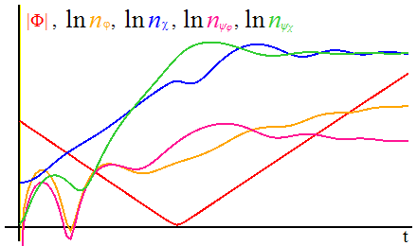
Numerical results : case 1 $( g=1, v=0.5, μ=0.05 )$
Trajectory:
Background
Number densities
$$1.0$$
$$ψ_{χ}$$
$$χ$$
10 e-3
$\left|φ\right|=$2
$$φ$$
$$ψ_{φ}$$
$$−1.0$$
$$1.0$$
10 e-4
$$\left|φ\right|$$
$$−1.0$$
Distributions
$$2.0$$
aqua color: analytical expected line
$$=2×\exp\left(−π\frac{k^{2}+g^{2}μ^{2}}{gv}\right)$$
$$1.0$$
$$ψ_{φ}$$
$$φ$$
$$χ$$
$$ψ_{χ}$$
$$0.5$$

Slide 22
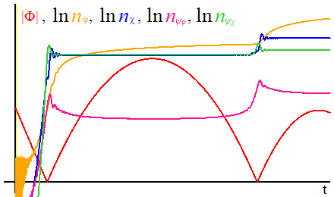
Numerical results : case 2 $( g=2, v=0.5, μ=0.05 )$
Trajectory:
Background
Number densities
$$φ$$
$$χ$$
$$1.0$$
10 e-2
$$ψ_{χ}$$
$$2.0$$
$\left|φ\right|=$5
10 e-3
$$−2.0$$
$$−1.0$$
$$1.0$$
$$ψ_{φ}$$
$$−1.0$$
10 e-4
$$\left|φ\right|$$
Distributions
aqua color: analytical expected line
$$=2×\exp\left(−π\frac{k^{2}+g^{2}μ^{2}}{gv}\right)$$
$$2.0$$
$$ψ_{χ}$$
$$φ$$
$$1.0$$
$$ψ_{φ}$$
$$χ$$
$$0.5$$
$$1.0$$

Slide 23
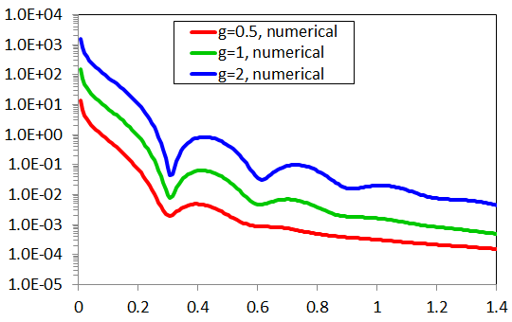
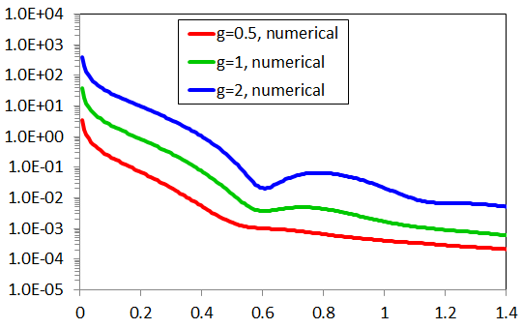
$$Im φ$$
Fitting function for distributions
(massless boson $φ$)
$$φ(t_{∗}+20)$$
$$φ(t_{∗}+10)$$
$$φ(t_{∗})$$
$$Re φ$$
$v=0.5$, $μ=0.05$
$$\left(t=t_{∗}+20\right)$$
$$\left(t=t_{∗}+10\right)$$
$$\frac{n_{φk}}{V}$$
momentum
$$k$$
momentum
$$k$$

Slide 24
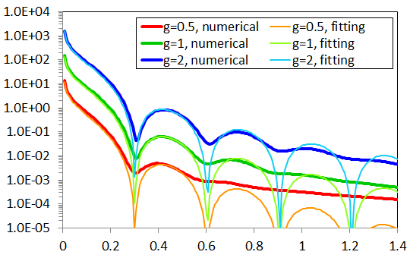
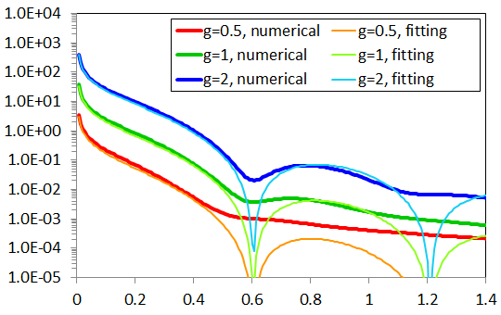
$$Im φ$$
Fitting function for distributions
(massless boson $φ$)
$$\frac{n_{φk}}{V}∼0.16\frac{g^{2}}{4π}⋅\frac{1}{\exp\left[\sqrt{πk^{2}/g\left|v\right|}\right]−1}⋅g\left|v\right|{\left(t−t_{∗}\right)}^{2}{\left[\frac{\sin{0.52k\left(t−t_{∗}\right)}}{0.52k\left(t−t_{∗}\right)}\right]}^{2}$$
$$φ(t_{∗}+20)$$
$$φ(t_{∗}+10)$$
$$φ(t_{∗})$$
$$Re φ$$
$v=0.5$, $μ=0.05$
$$\left(t=t_{∗}+20\right)$$
$$\left(t=t_{∗}+10\right)$$
$$\frac{n_{φk}}{V}$$
momentum
$$k$$
momentum
$$k$$
Perturbative suppression factor
Equilibrium distribution
Time evolution part

Slide 25
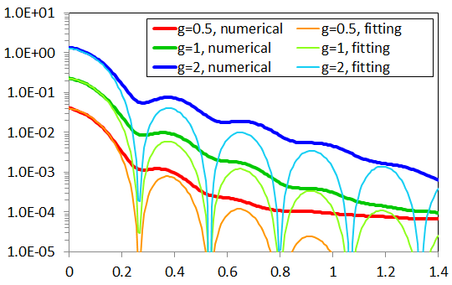
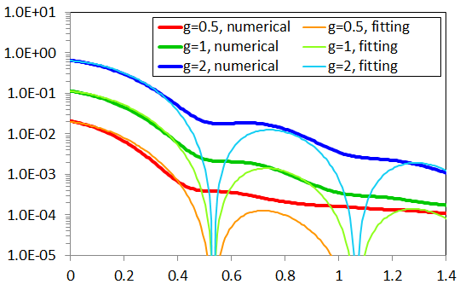
$$Im φ$$
Fitting function for distributions
(massless fermion $ψ_{φ}$)
$$φ(t_{∗}+20)$$
$$φ(t_{∗}+10)$$
$$φ(t_{∗})$$
$$Re φ$$
$v=0.5$, $μ=0.05$
$$\left(t=t_{∗}+20\right)$$
$$\left(t=t_{∗}+10\right)$$
$$\frac{n_{ψ_{φ}k}}{V}$$
momentum
$$k$$
momentum
$$k$$
$$\frac{n_{φk}}{V}∼0.40\frac{g^{2}}{4π}⋅\frac{1}{\exp\left[\sqrt{πk^{2}/g\left|v\right|}\right]+1}⋅\sqrt{g\left|v\right|{\left(t−t_{∗}\right)}^{2}}{\left[\frac{\sin{0.59k\left(t−t_{∗}\right)}}{0.59k\left(t−t_{∗}\right)}\right]}^{2}$$
Perturbative suppression factor
Equilibrium distribution
Time evolution part

Slide 26
4. Summary
We have found the Bogoliubov transformation law in the interacting theory using the Yang-Feldman formalism
In general, particle production is possible even if $β_{k}=0$
We calculated produced particle’s (occupation) number
$\frac{n_{χk}}{V}=\frac{n_{ψ_{χ}k}^{}}{V}∼2\exp\left[−π\frac{k^{2}+g^{2}μ^{2}}{gv}\right]$ (analytical results)
$\frac{n_{φk}}{V},\frac{n_{ψ_{φ}k}}{V}∝\frac{g^{2}}{4π}×$ (Eq. distribution) (fitting)
Massive and massless particles are produced at the same time
The main channel of massless particle production is inverse decay
Although the produced number of massless particles is suppressed by $g^{2}/4π$, it is possible to create a sizable amount of particles if the coupling is reasonably strong

