Slide 1
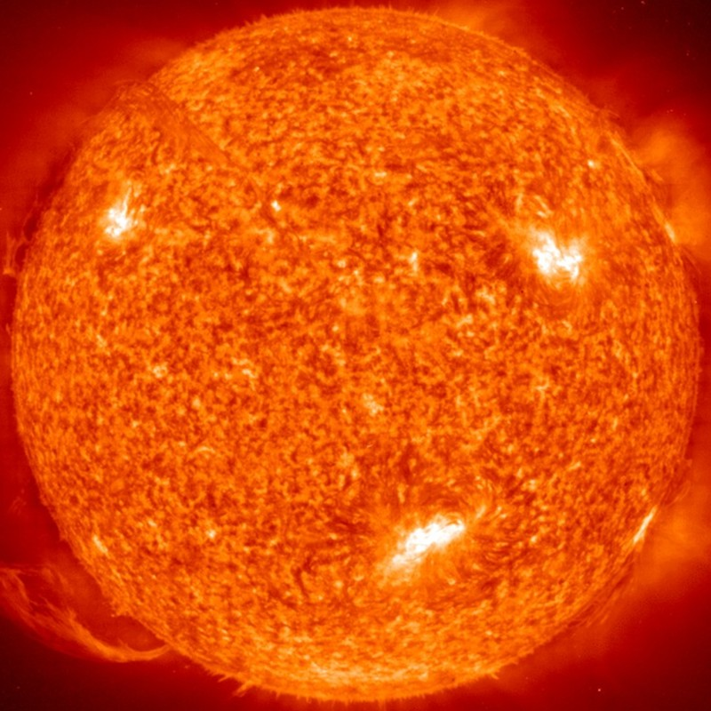
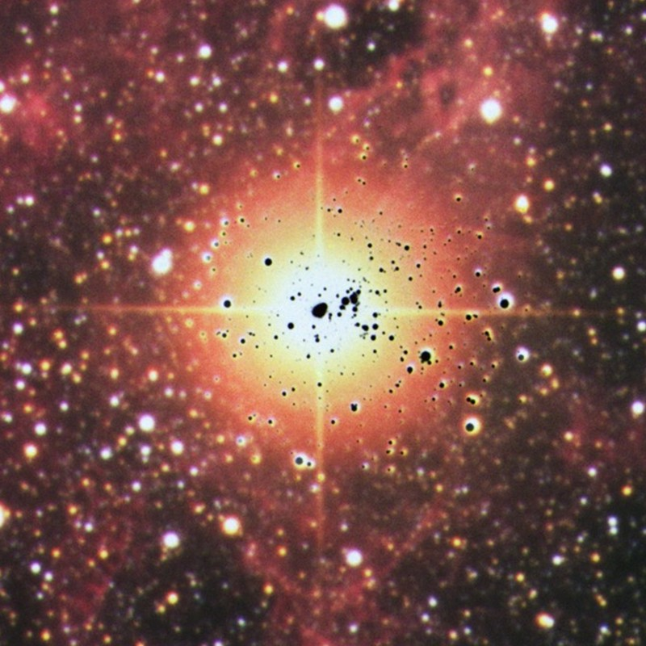
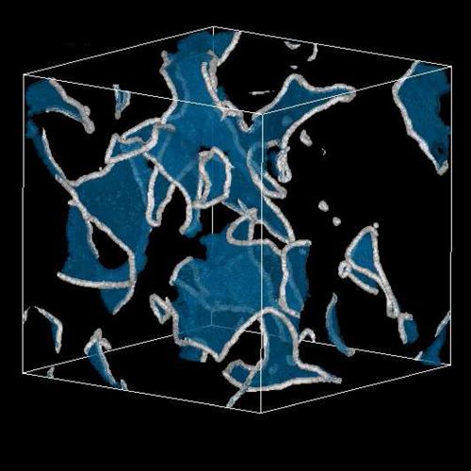
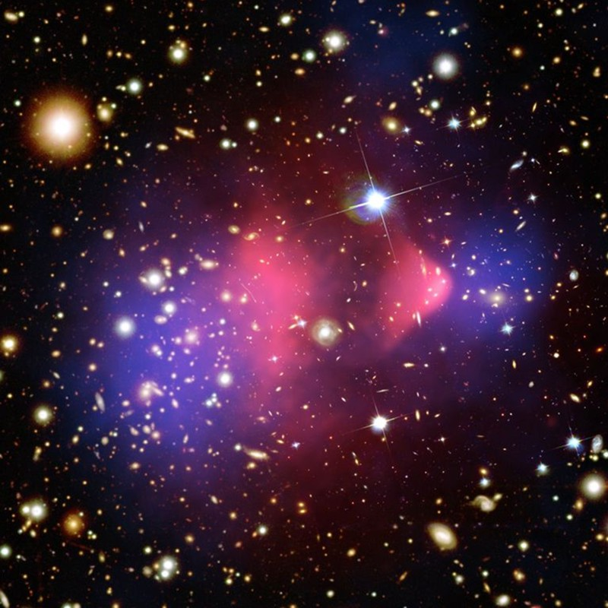
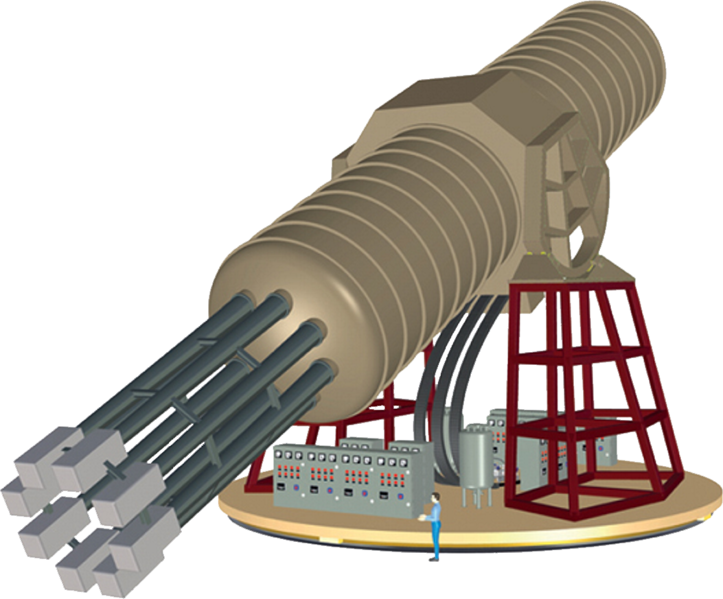
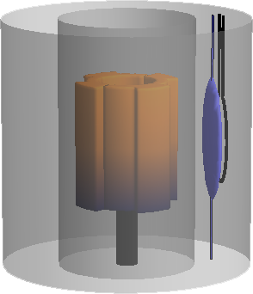
Axion Landscape
Solar Axions
Supernova 1987A
Early Universe
Dark Matter
Long-Range Force
Georg Raffelt
Max Planck Institute for Physics, Munich

Slide 2
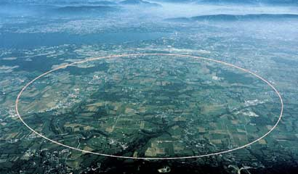
High- and Low-Energy Frontiers in Particle Physics
Cosmological
constant
QCD
scale
Electroweak
scale
GUT
scale
Planck
mass
$${10}^{−6}$$
$${10}^{−3}$$
$$1$$
$${10}^{3}$$
$${10}^{6}$$
$${10}^{9}$$
$${10}^{12}$$
$${10}^{15}$$
$${10}^{18}$$
$${10}^{21}$$
$${10}^{24}$$
$${10}^{27}$$
eV
CERN
“Intensity Frontier”
(feeble interactions)
Low-E Frontier
High-Energy Frontier
New 750 GeV boson?
few-sigma hint @ CMS & ATLAS
many theory papers since Dec 2015

Slide 3
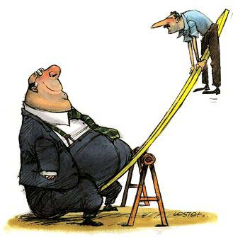
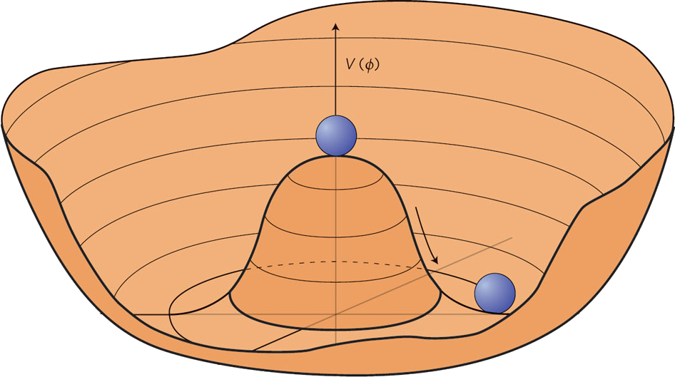
High- and Low-Energy Frontiers in Particle Physics
Cosmological
constant
QCD
scale
Electroweak
scale
GUT
scale
Planck
mass
$${10}^{−6}$$
$${10}^{−3}$$
$$1$$
$${10}^{3}$$
$${10}^{6}$$
$${10}^{9}$$
$${10}^{12}$$
$${10}^{15}$$
$${10}^{18}$$
$${10}^{21}$$
$${10}^{24}$$
$${10}^{27}$$
eV
Heavy right-handed
neutrinos
(see-saw mechanism)
$$\frac{m_{D}^{2}}{M}$$
$$m_{D}$$
$$M$$
WIMP dark matter
(related to EW scale, perhaps SUSY)
Axion dark matter (related to Peccei-Quinn symmetry)
$$m_{a}∼\frac{m_{π}f_{π}}{f_{a}}$$
$$m_{π}{, f}_{π}$$
$$f_{a}$$

Slide 4
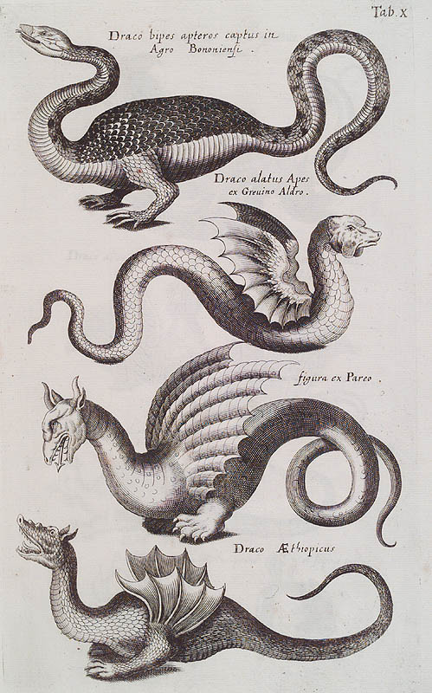
Bestiarium of Low-Mass Bosons
Weakly Interacting Sub-eV Particles (WISPs)
• Axions (1 parameter family $m_{a}f_{a}∼m_{π}f_{π}$)
Solves strong CP problem
Could be dark matter
• Axion-like particles (ALPs)
Generic two-photon vertex, could be dark matter
(2 parameters $m_{a}$ and $g_{aγ}$)
• String axions
(almost massless pseudoscalars in string theory)
One of them may solve CP problem
• Hidden photons
Low-mass gauge bosons from $U′(1)$
(kinetic mixing parameter $χ$ and mass $m_{γ′}^{}$)
• Chameleons
Scalars in certain models of scalar-tensor gravity
Motivated by dark energy
Environment-dependent properties

Slide 5
The CP Problem of Strong Interactions
Real quark
mass
Phase from
Yukawa coupling
Angle
variable
CP-odd
quantity $∼E⋅B$
$$ℒ_{QCD}=\sum_{q}{{\overline{ψ}}_{q}\left(iD−m_{q}e^{iθ_{q}}\right)ψ_{q}−\frac{1}{4}}G_{μνa}G_{a}^{μν}−Θ\frac{α_{s}}{8π}G_{μνa}{\tilde{G}}_{a}^{μν}$$
Remove phase of mass term by chiral transformation of quark fields
$$ψ_{q}→e_{}^{−iγ_{5}θ_{q}/2}ψ_{q}$$
$$ℒ_{QCD}=\sum_{q}{{\overline{ψ}}_{q}\left(iD−m_{q}\right)ψ_{q}−\frac{1}{4}}GG−\underset{−π ≤\overline{Θ}≤+π}{\underbrace{\left(Θ−\text{arg} \text{det} M_{q}\right)}} \frac{α_{s}}{8π}G\tilde{G}$$
$\overline{Θ}$ can be traded between quark phases and $G\tilde{G}$ term
No physical impact if at least one $m_{q}=0$
Induces a large neutron electric dipole moment (a T-violating quantity)
Experimental limits: $\left|\overline{Θ}\right|<{10}^{−11}$ Why so small?

Slide 6
Strong CP Problem
QCD vacuum energy $V(Θ)$
$$Λ_{QCD}^{4}$$
Equivalent
Equivalent
$$Θ$$
$$−2π$$
$$−π$$
$$+π$$
$$+2π$$
• CP conserving vacuum has $Θ=0$ (Vafa and Witten 1984)
• QCD could have any $−π≤Θ≤+π$, is “constant of nature”
• Energy can not be minimized: $Θ$ not dynamical
Peccei-Quinn solution:
Make $Θ$ dynamical, let system relax to lowest energy

Slide 7
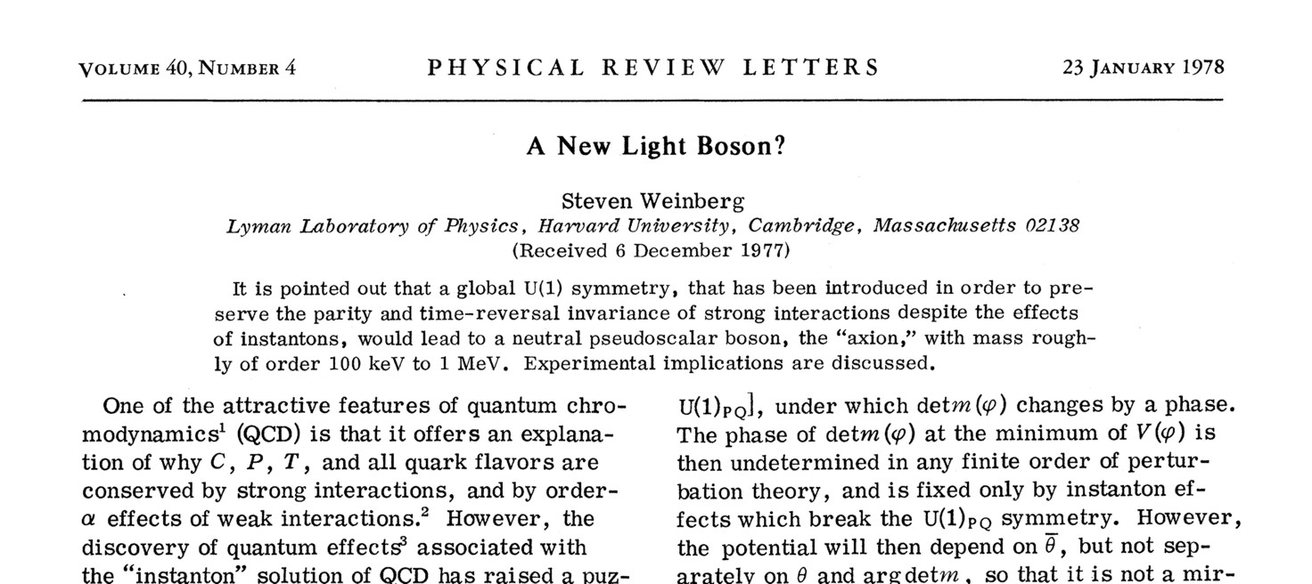
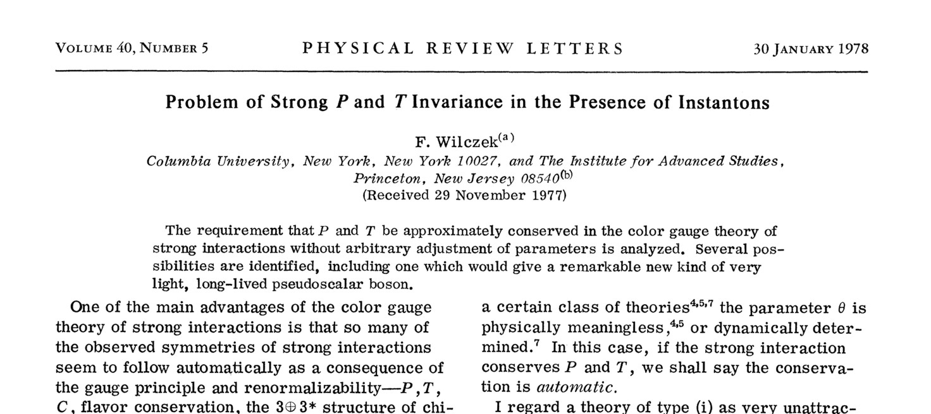
38 Years of Axions

Slide 8
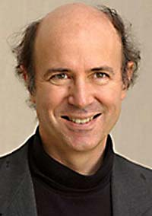
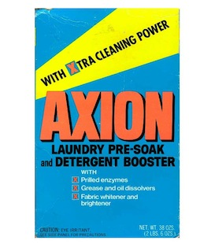
The Cleansing Axion
Frank Wilczek
“I named them after a laundry
detergent, since they clean up
a problem with an axial current.”
(Nobel lecture 2004)

Slide 9
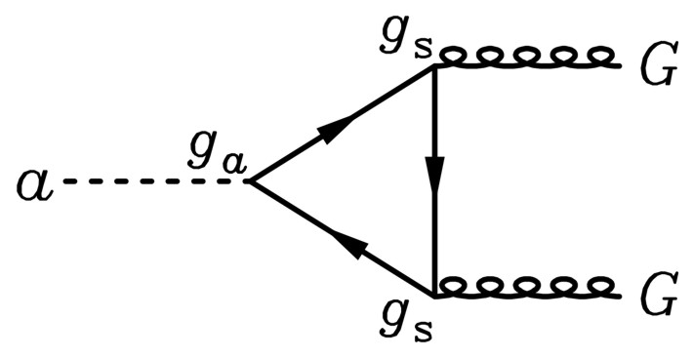
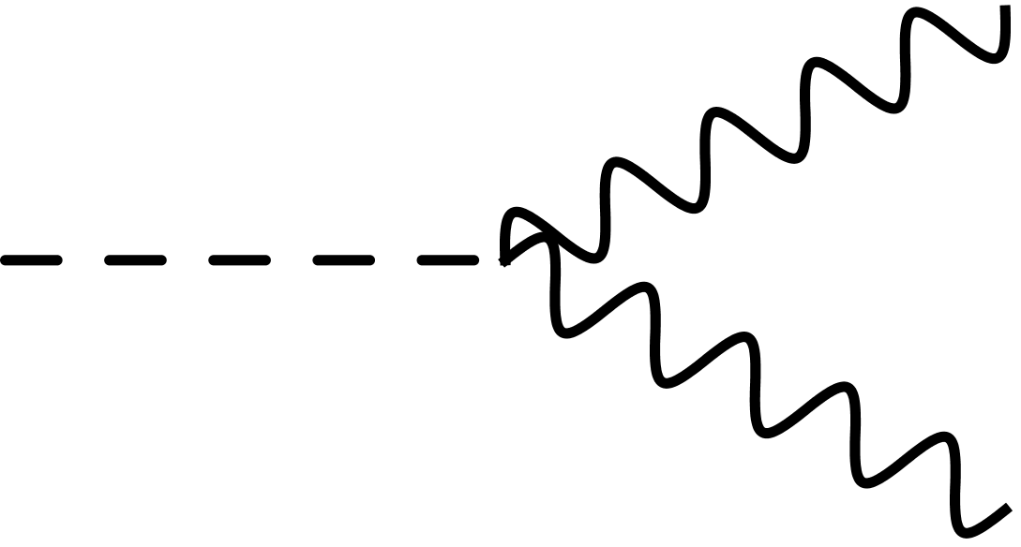
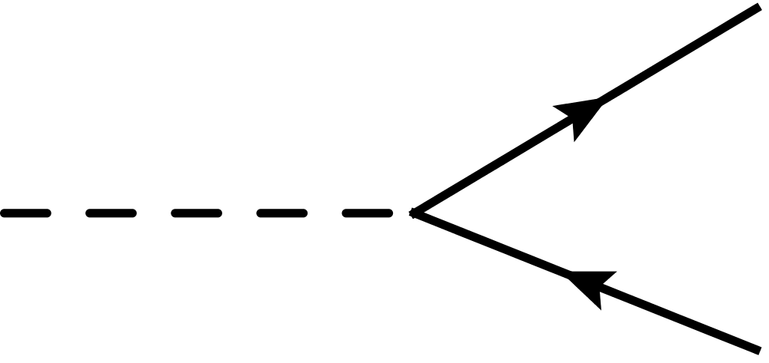
Phenomenological Axion Properties
Gluon coupling (generic), defines normalization of axion scale $f_{a}$
$${ ℒ}_{aG}=\frac{α_{s}}{8π} \frac{a}{f_{a}}G\tilde{G}$$
Mass (generic) depends on up/down quark masses
$$m_{a}=\frac{\sqrt{m_{u}m_{d}}}{m_{u}+m_{d}} \frac{m_{π}}{f_{π}f_{a}}≈\frac{6 μeV}{{f_{a}}/{{10}^{12}}GeV}$$
Axion-photon coupling (model dependent)
$${ ℒ}_{aγ}=−\frac{g_{aγ}}{4} F\tilde{F}a=g_{aγ} E⋅B a=\frac{α}{2π}\left(\frac{E}{N}−1.92\right)\frac{a}{f_{a}}E⋅B$$
Generic from $a$-$π$-$η$ mixing
$$γ$$
$$a$$
Model-dependent,
E/N = 0 (KSVZ), 8/3 (DFSZ), many others
$$γ$$
Axion-nucleon coupling (model-dependent numerical factors $C_{N}$)
$${ ℒ}_{aN}=C_{N} {\overline{Ψ}}_{N}γ^{μ}γ_{5}Ψ_{N}\frac{∂_{μ}a}{2f_{a}}$$
Axion-electron coupling in non-hadronic models is analogous with $C_{e}$
$$f$$
• Axial-vector current
• Spin-dependent int’n
$$a$$
$$f$$

Slide 10
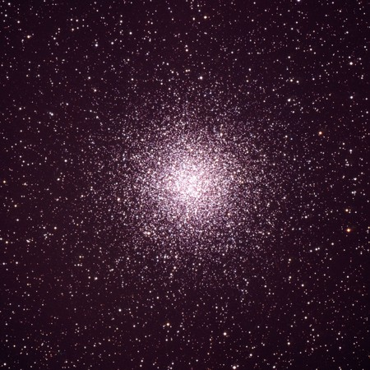
Axion Bounds
m_{Planck}
f_{a}
10¹⁸
10¹⁵
10¹²
10⁹
10⁶
GeV
peV
neV
μeV
meV
eV
m_{a}
Astrophysical Bounds
(Energy loss of stars)
Opportunities for detection
Supernova 1987A
Globular Cluster

Slide 11
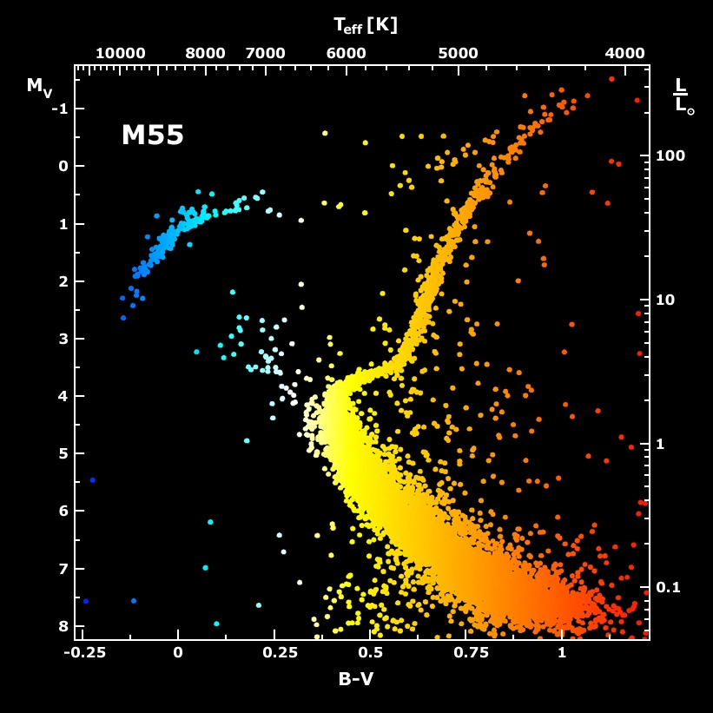
Galactic Globular Clusters

Slide 12
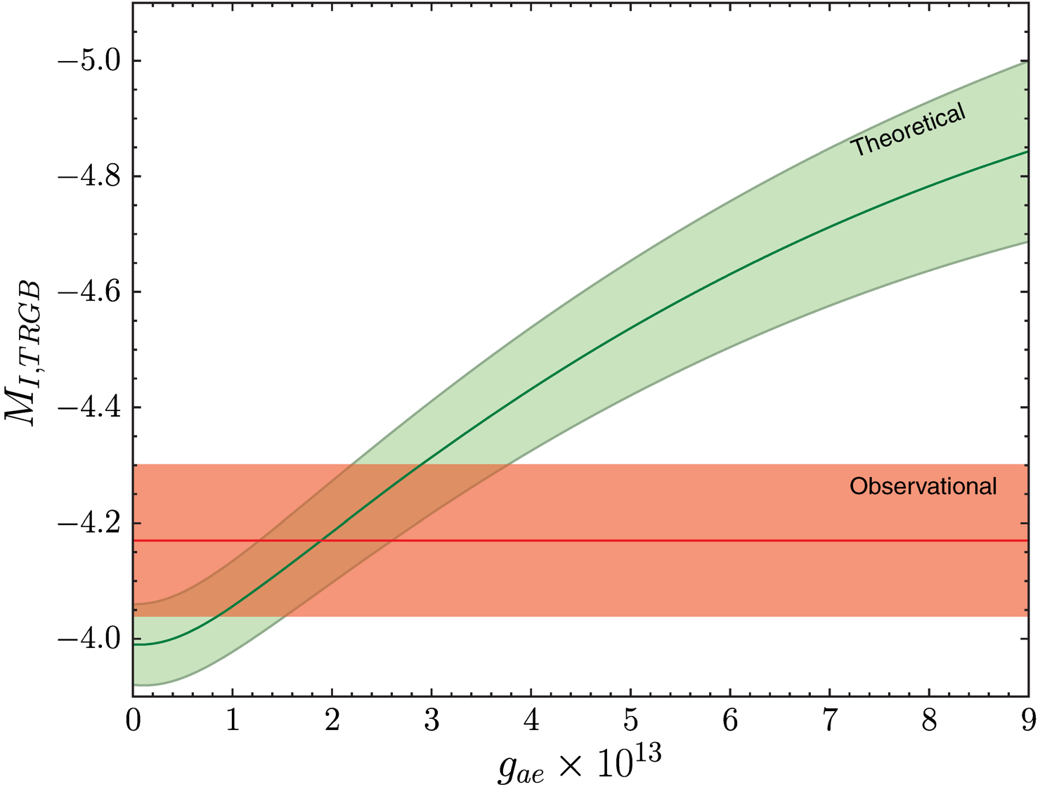
Limits on Axion-Electron Coupling from GC M5
I-band brightness
of tip of red-giant brach
[magnitudes]
Detailed account of theoretical and observational uncertainties
• Uncertainty dominated
by distance
• Can be improved in
future (GAIA mission)
Axion-electron Yukawa $g_{ae}×{10}^{13}$
Limit on axion-electron Yukawa
Mass limit in DFSZ model
$$g_{ae}<\left\{\begin{matrix}2.6×{10}^{−13} & (68\% CL) \\ 4.3×{10}^{−13} & (95\% CL)\end{matrix}\right.$$
$$m_{a}\cos^{2}{β}<\left\{\begin{matrix} 9.3 meV & (68\% CL) \\ 15.4 meV & (95\% CL)\end{matrix}\right.$$
Viaux, Catelan, Stetson, Raffelt, Redondo, Valcarce & Weiss, arXiv:1311.1669

Slide 13
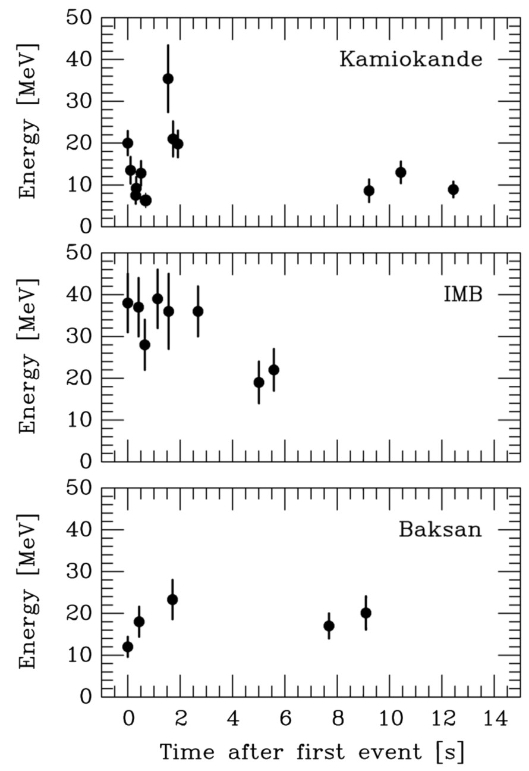
Supernova 1987A Energy-Loss Argument
SN 1987A neutrino signal
Neutrino
sphere
Volume emission
of new particles
Neutrino
diffusion
Emission of very weakly interacting
particles would “steal” energy from the
neutrino burst and shorten it.
(Early neutrino burst powered by accretion,
not sensitive to volume energy loss.)
Late-time signal most sensitive observable

Slide 14
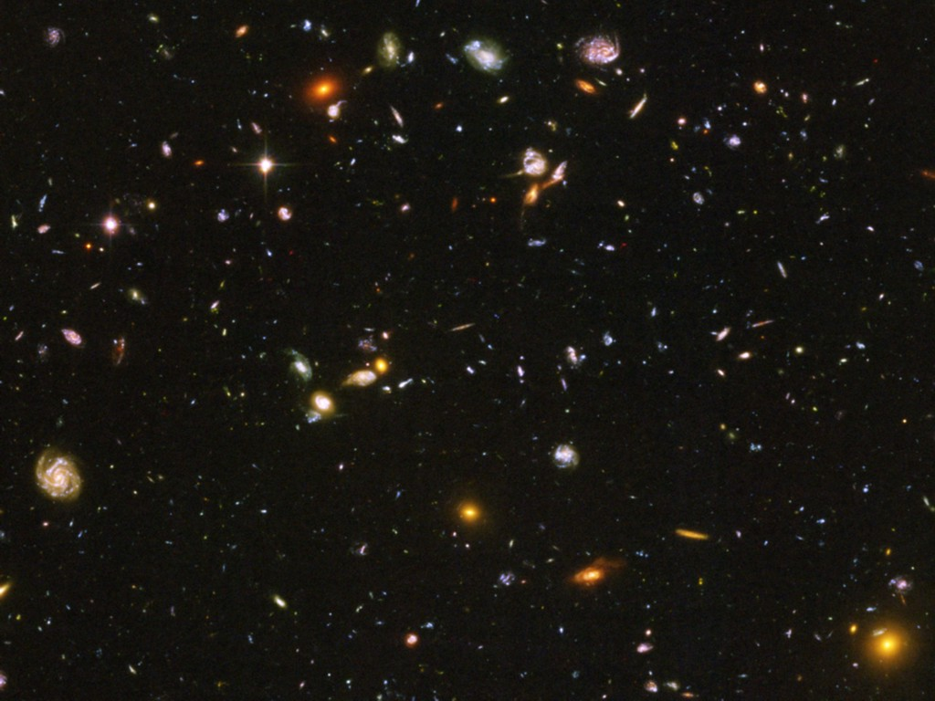
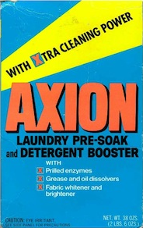
Pie Chart of Dark Matter of the Universe
Dark Energy 70%
(Cosmological Constant)
Neutrinos
0.1−0.4%
Ordinary Matter 5%
(of this only about
10% luminous)
Dark Matter
25%

Slide 15
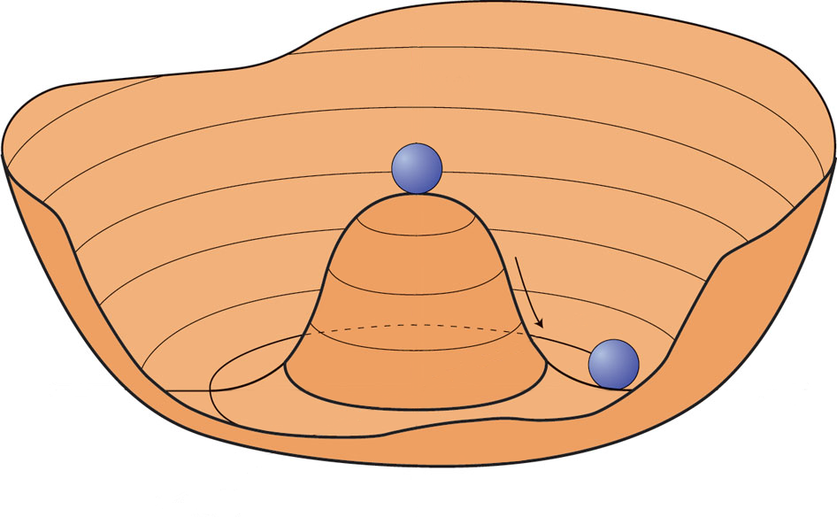
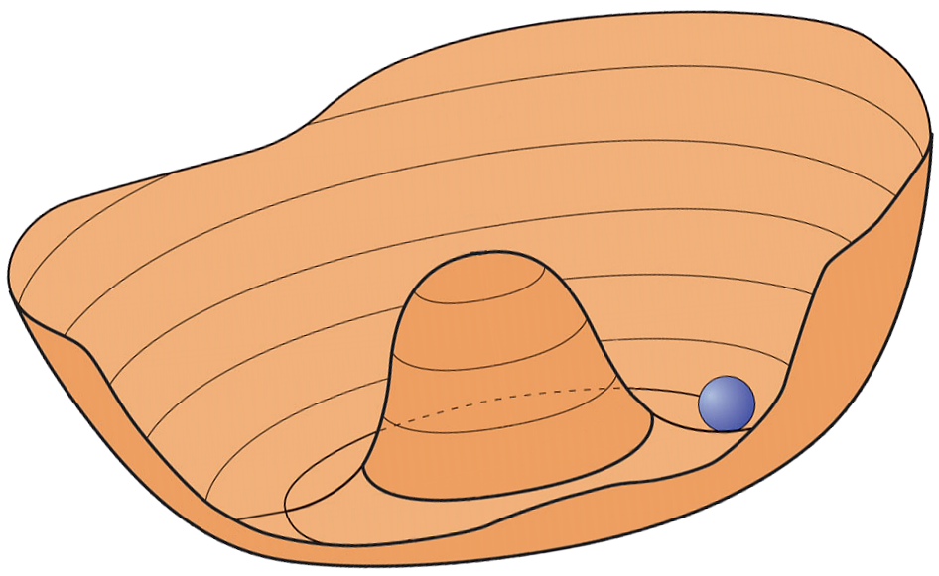
Creation of Cosmological Axions by Re-alignment
$T \sim f_{a}$ (very early universe)
U_{PQ}(1) spontaneously broken
Higgs field settles in “Mexican hat”
Axion field sits fixed at $ai =Θi f_{a}$
$$V(a)$$
$$a$$
$T \sim 1 \text{GeV}$ ($H \sim {10}^{−9}$ eV)
Axion mass turns on quickly
by thermal instanton gas
Field starts oscillating when
$ma ≳ 3H$
Classical field oscillations (axions at rest)
$$V(a)$$
$$a$$
$$\overline{Θ}=0$$
Axions are born as nonrelativistic, classical field oscillations
Very small mass, yet cold dark matter

Slide 16
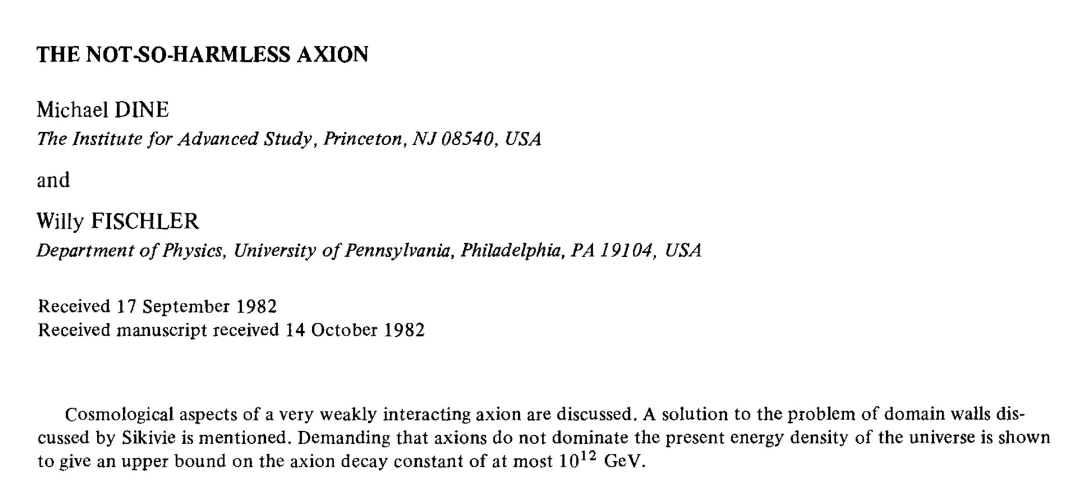
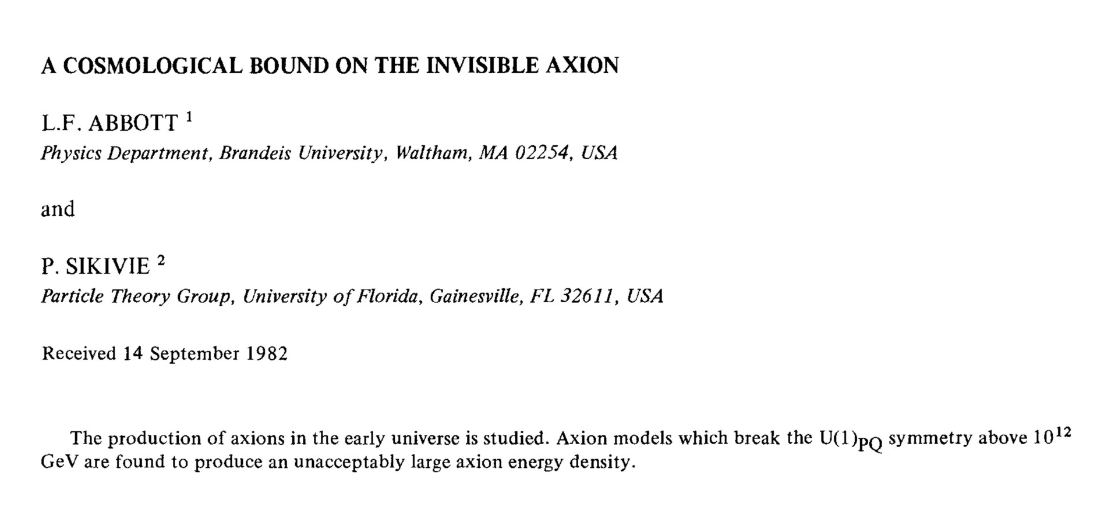
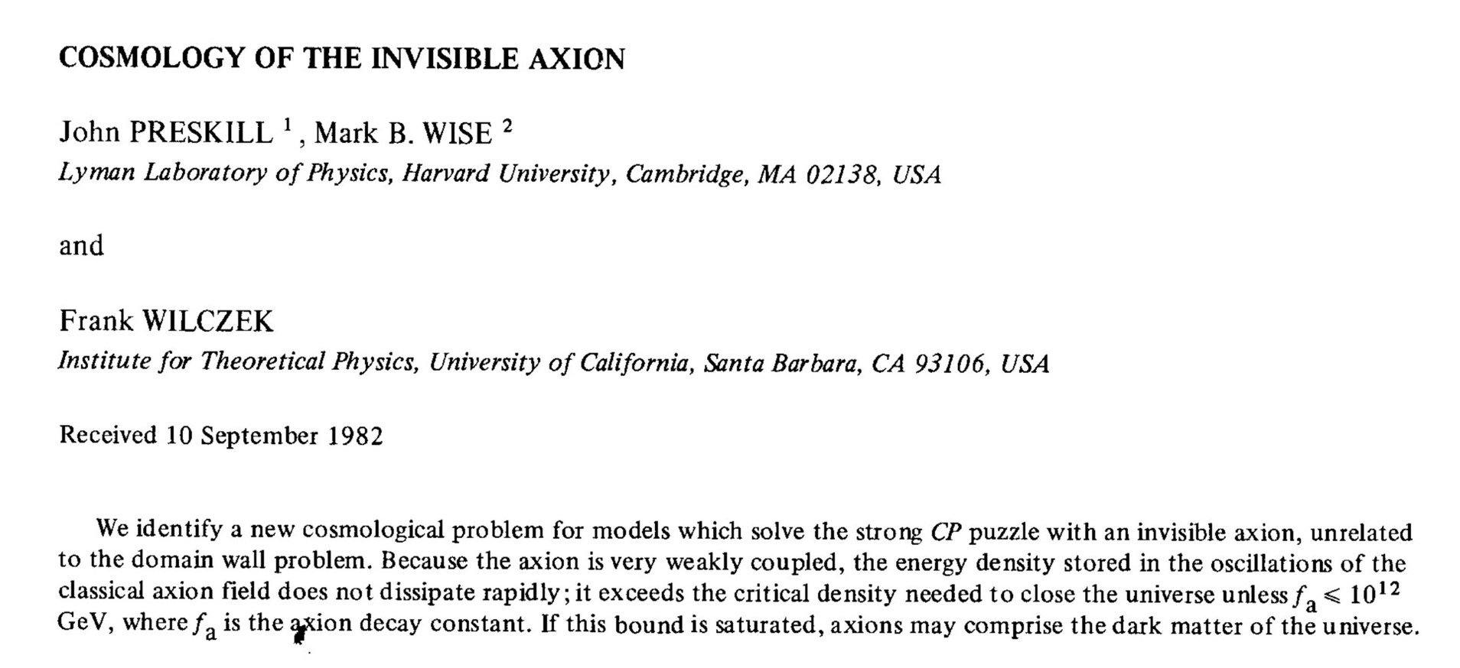
Axion Cosmology in PLB 120 (1983)

Slide 17
Galactic WIMP vs Axion Dark Matter
Local dark matter density around 0.3 GeV/cm³
WIMPs: Typical mass 100 GeV
• Local number density:
$3000 m^{−3} \frac{100 GeV}{m_{WIMP}}$
Dilute gas of particles
Axions: Typical mass 10 μeV
• Local number density:
$3×10^{19} m^{−3} \frac{10 μeV}{m_{a}}$
• Typical galactic virial velocity:
$v_{gal}∼10^{−3} c$
• Typical de Broglie wavelength
(“localisation”)
$λ∼\frac{2π}{m_{a}v_{gal}}∼100 m \frac{10 μeV}{m_{a}}$
• Minimal occupation number
$f∼10^{25} {\left(\frac{10 μeV}{m_{a}}\right)}^{4}$
Highly degenerate Bose gas!

Slide 18
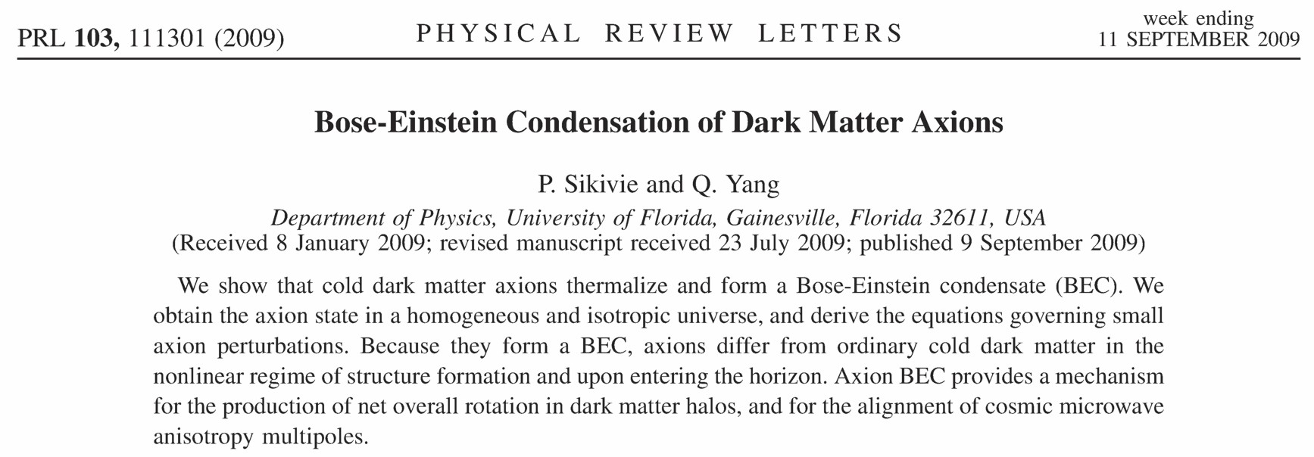
BEC Formation
~170 citations
• Axions ~ WIMP dark matter on scales $≫$ axion de Broglie wavelength?
• Larger-range correlation established by BEC dynamics? (Observable?)
• BEC formation caused by gravitational interactions possible?
See also • Erken, Sikivie, Tam & Yang, arXiv:1111.1157
• Saikawa & Yamaguchi, arXiv:1210.7080
• Noumi, Saikawa, Sato & Yamaguchi, arXiv:1310.0167
• Davidson & Elmer, arXiv:1307.8024, Davidson, arXiv:1405.1139
• Berges & Jaeckel, arXiv:1402.4776
• Guth, Hertzberg & Prescod-Weinstein, arXiv:1412.5930

Slide 19
Axion Dark Matter Driving Oscillators
$$Λ_{QCD}^{4}$$
Oscillating axion field (DM)
→ Oscillating Θ term
• Drives oscillating neutron EDM
• Drives oscillating E-field in
microwave cavity w/ B-field
$$Θ=a/f_{a}$$
$$−π$$
$$+π$$
Assume axions are the galactic dark matter: $ρ_{a} \sim$ 300 MeV/cm³
$ρ_{a}=\frac{1}{2}m_{a}^{2}Φ_{a}^{2}={\frac{1}{2}m}_{a}^{2}{\left(Θf_{a}\right)}^{2}∼Θ^{2}{\left(m_{π}f_{π}\right)}^{2}∼Θ^{2}Λ_{\text{QCD}}^{4}$
$Θ\left(t\right)=a\left(t\right)/f_{a}∼3×{10}^{−19} cos\left(m_{a}t\right)$
n
Axion-induced
electric field
oscillating with
$$ω=m_{a}$$
Neutron EDM
oscillating with
$$ω=m_{a}$$
External
static
B-field

Slide 20
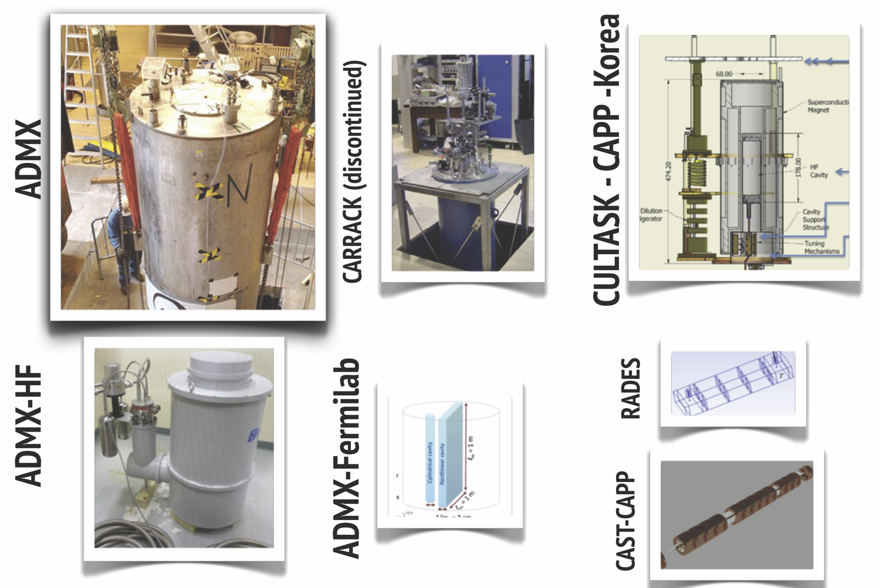
Landscape of Cavity Experiments
Adapted from Javier Redondo

Slide 21
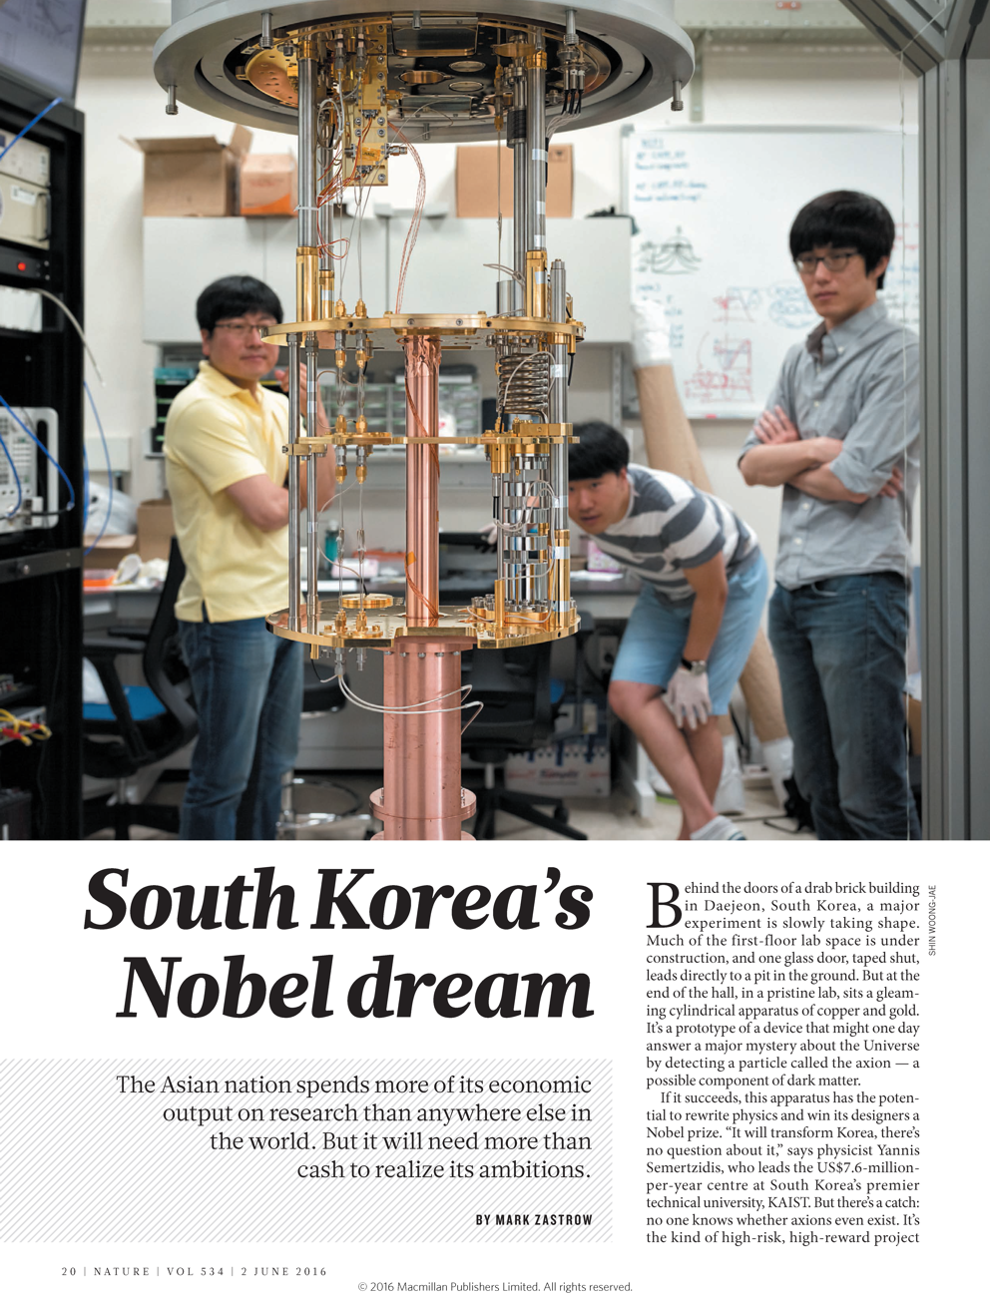
Nobel Dreams

Slide 22
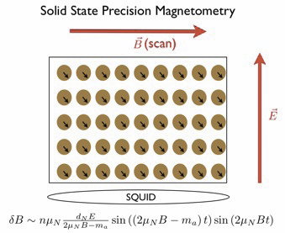
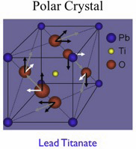
Searching for Axions in the Anthropic Range
CASPEr experiment
Precise magnetometry to measure
tiny deviations from Larmor frequency
Graham & Rajendran, arXiv:1101.2691
Budker, Graham, Ledbetter, Rajendran & Sushkov, arXiv:1306.6089

Slide 23
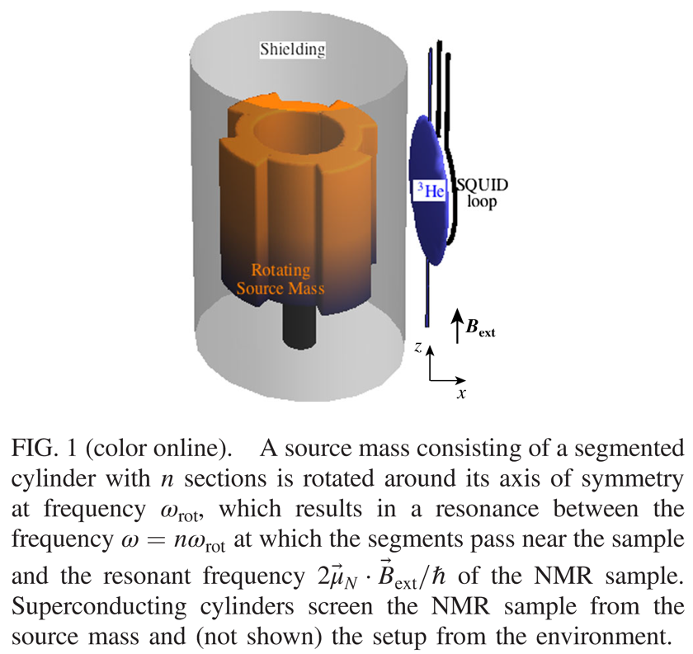
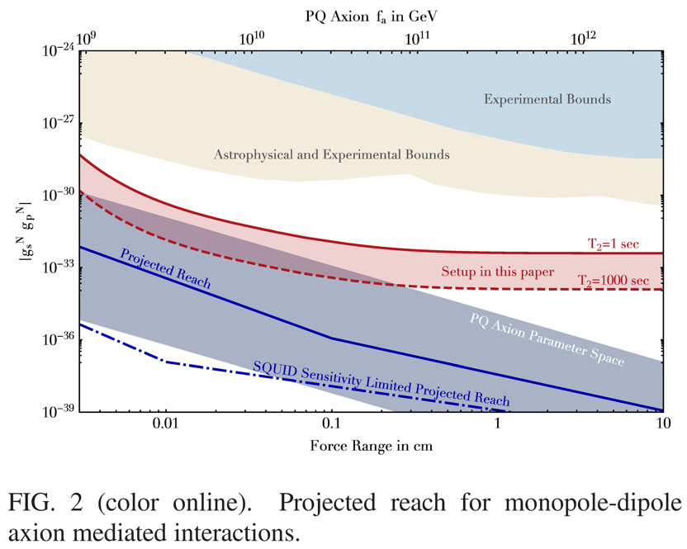
NMR Experiment
ARIADNE: Axion Resonant InterAction DetectioN Experiment
A.Geraci, A.Arvanitaki, A.Kapitulnik, Chen-Yu Liu, J.Long, Y.Semertzidis, M.Snow
(to be supported by NSF and/or DoE?)

Slide 24
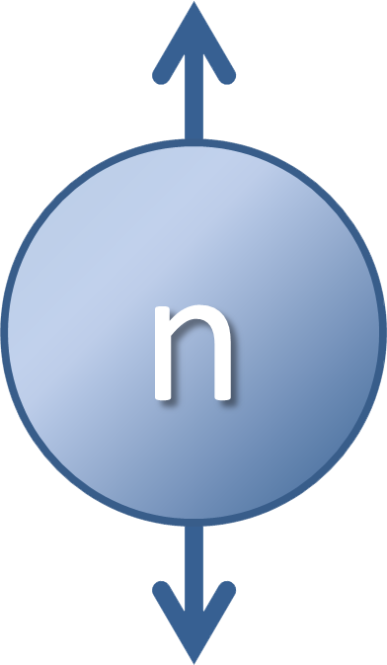
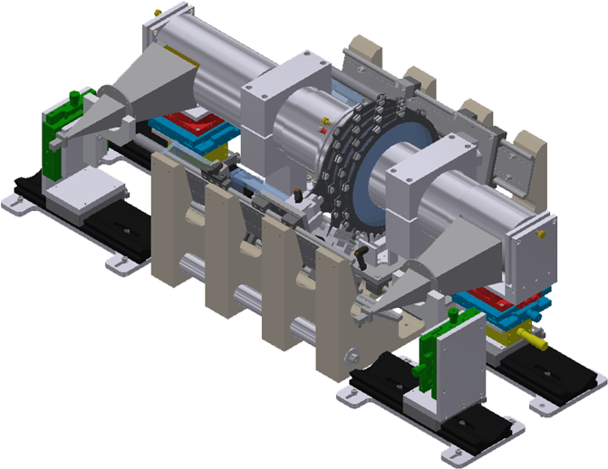
Axion Searches
m_{Planck}
f_{a}
10¹⁸
10¹⁵
10¹²
10⁹
10⁶
GeV
peV
neV
μeV
meV
eV
m_{a}
kHz
MHz
GHz
THz
ν_{a}
Taking
data
CASPEr
Astrophysical Bounds
(Energy loss of stars)
ARIADNE

Slide 25
Looking for axion-like particles (ALPs)

Slide 26
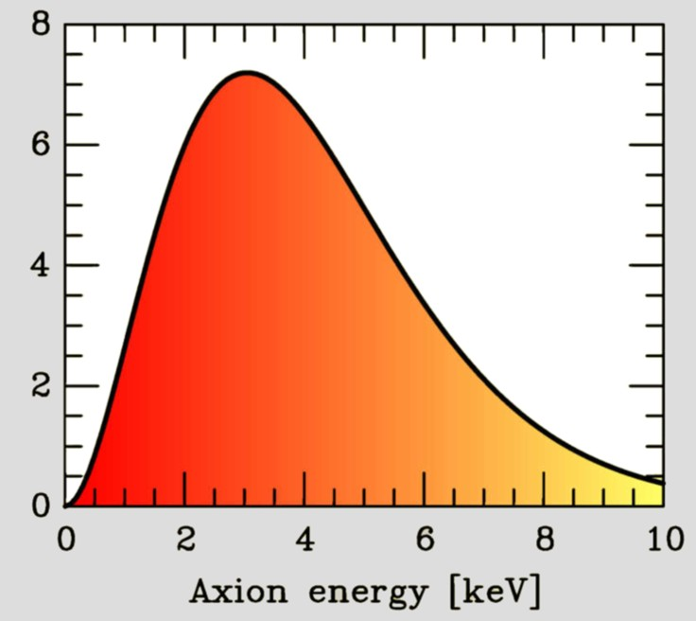
Search for Solar Axions
Axion Helioscope
(Sikivie 1983)
Primakoff
production
Axion flux
N
γ
a
a
γ
Magnet S
Axion-Photon-Oscillation
Sun
Tokyo Axion Helioscope (“Sumico”)
(Results since 1998, up again 2008)
CERN Axion Solar Telescope (CAST)
(Data taking 2003–2015)
Alternative technique:
Bragg conversion in crystal
Experimental limits on solar axion flux
from dark-matter experiments
(SOLAX, COSME, DAMA, CDMS ...)

Slide 27
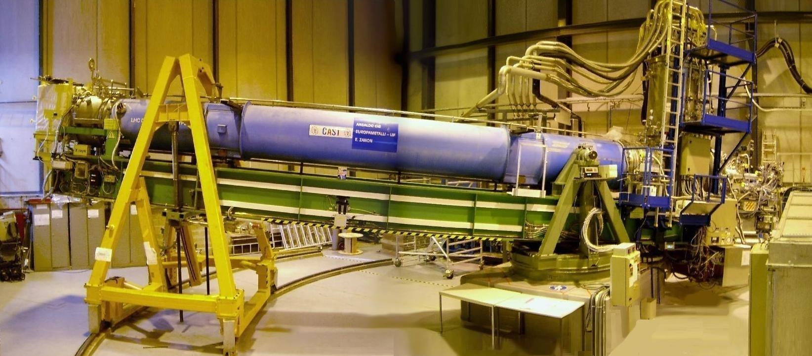
CERN Axion Solar Telescope (CAST)

Slide 28
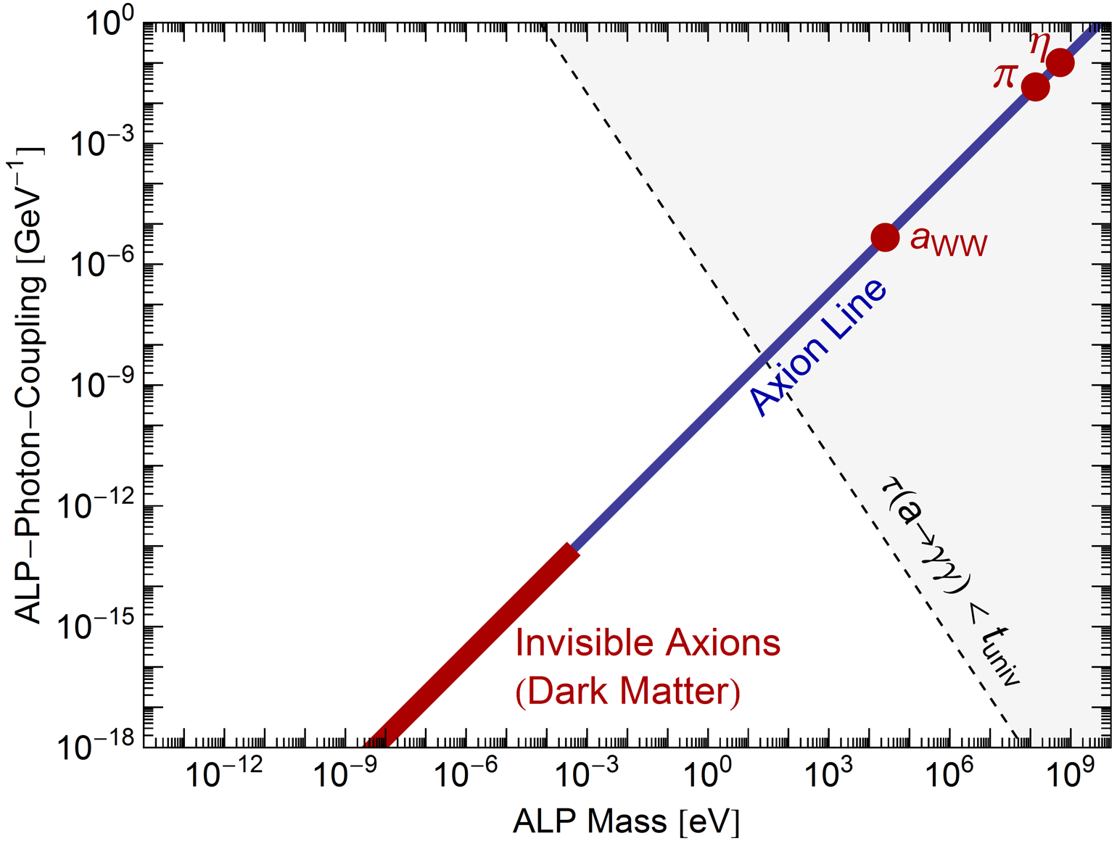
Parameter Space for Axion-Like Particles (ALPs)
Two parameters:
- ALP mass $m_{a}$
- ALP-$γ$ coupling $g_{aγ}$
Weinberg Wilczek
“standard axion”
Model dependence
(KSVZ, DFSZ, …) broadens
the “axion line”
$$Γ_{a→γγ}=\frac{g_{aγ}^{2}m_{a}^{3}}{64π}$$

Slide 29
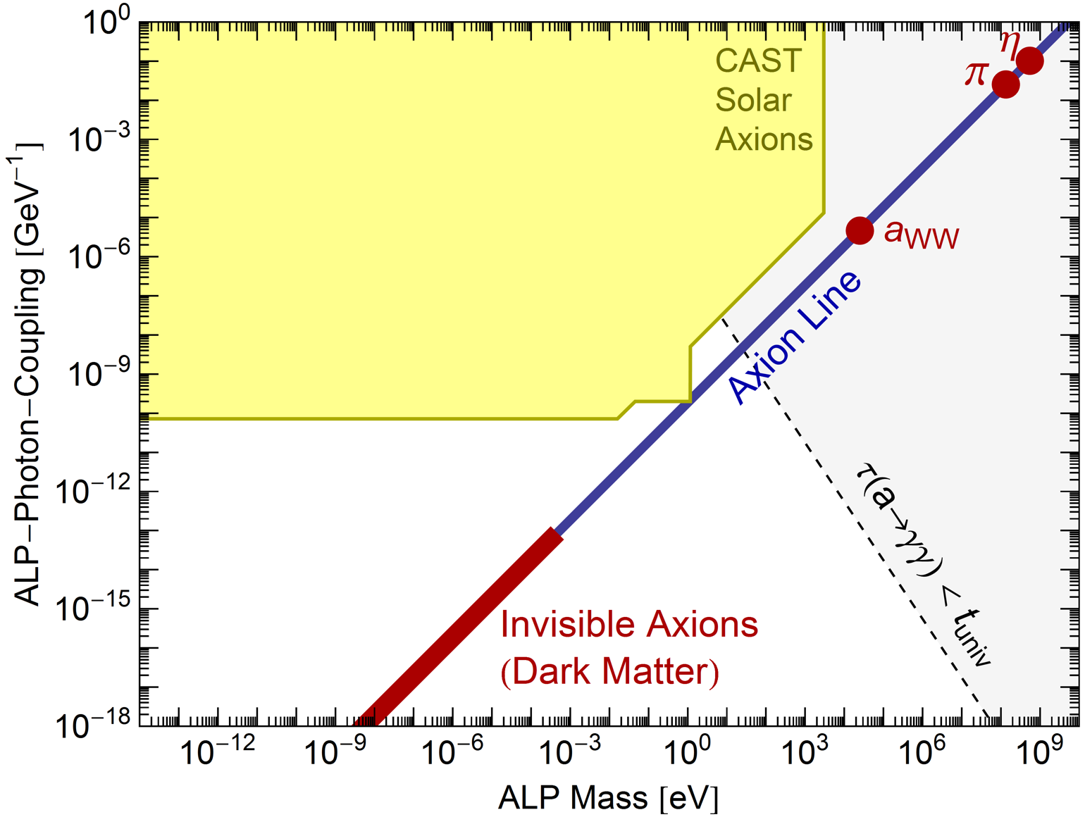
Parameter Space for Axion-Like Particles (ALPs)
CAST exclusion range
End of solar
spectrum
Large $m_{a}$, $a$-$γ$-oscillations
suppressed
$a$-$γ$-oscillations enhanced
with He filling ($m_{γ}∼m_{a}$)
Maximal mixing
(“coherent”, small $m_{a}$)

Slide 30
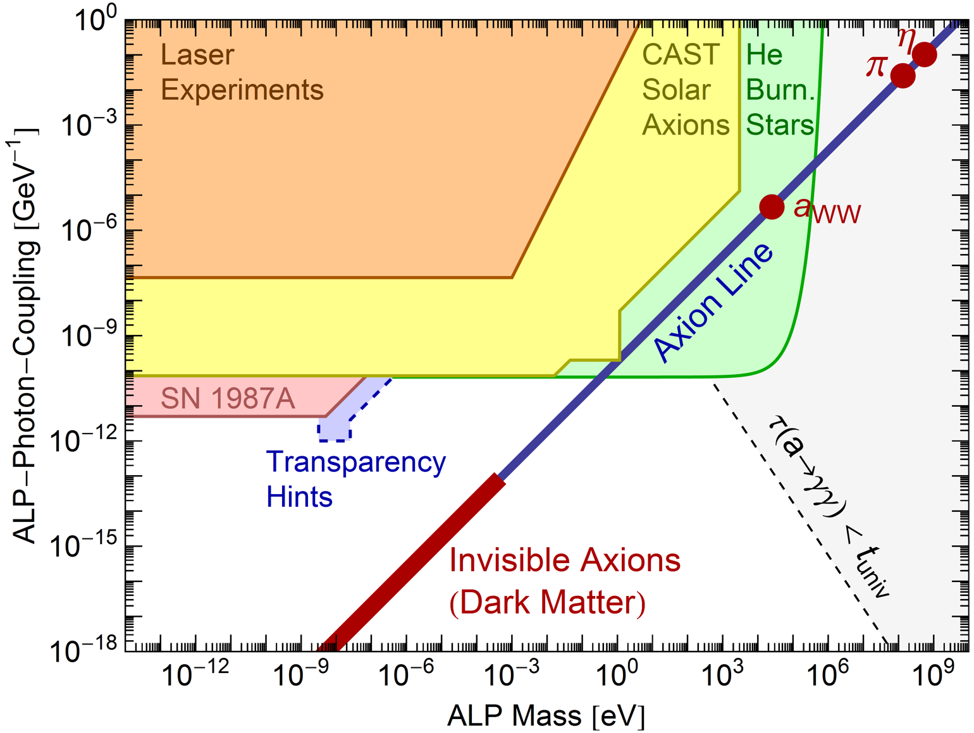
Parameter Space for Axion-Like Particles (ALPs)
ALPS-II at DESY

Slide 31
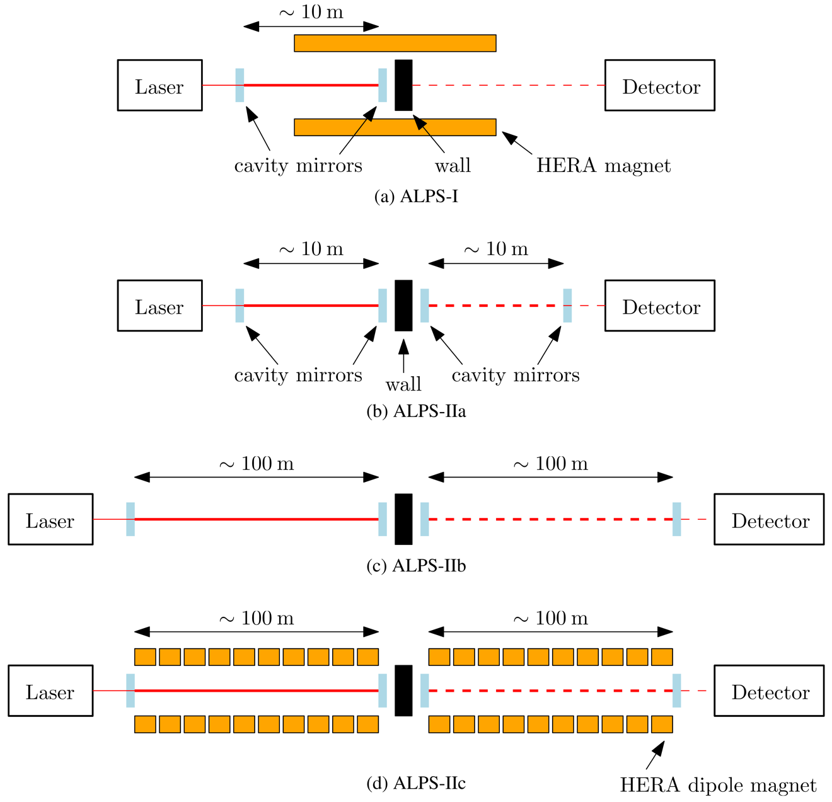
Any Light Particle Search II (ALPS-II) at DESY
ALPS-I (finished)
ALPS-IIa (2014)
ALPS-IIb (2015)
ALPS-IIc (2017)
ALPS-II Technical Design Report, arXiv:1302.5647

Slide 32
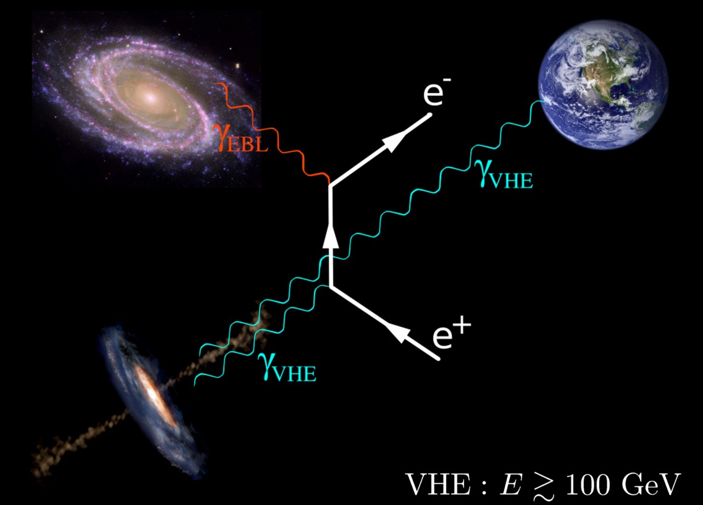
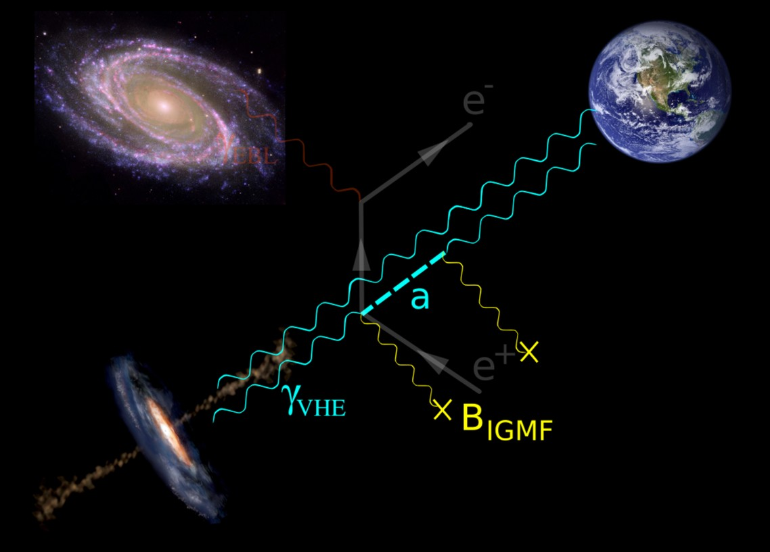
Shining TeV Gamma Rays through the Universe
Figure from a talk by Manuel Meyer (Univ. Hamburg)

Slide 33
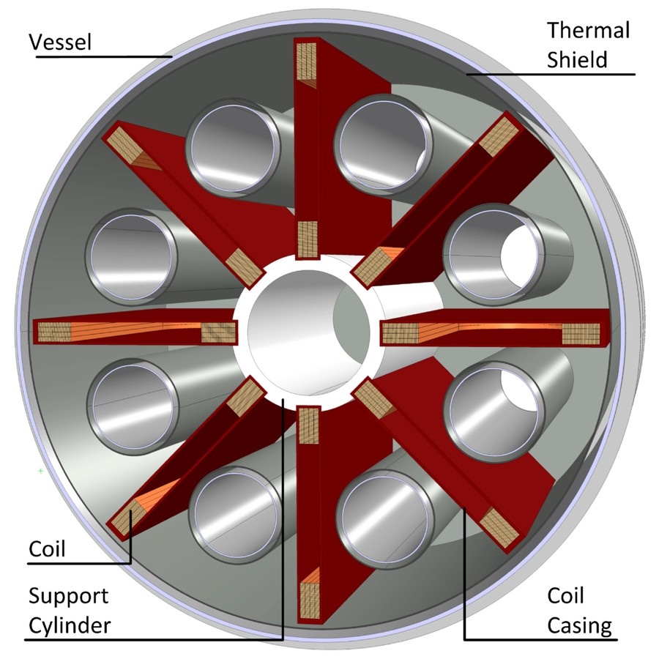
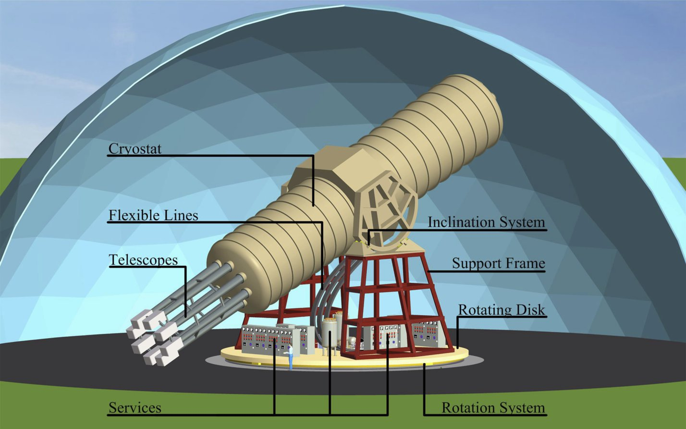
Next Generation Axion Helioscope (IAXO) at CERN
Need new magnet w/
– Much bigger aperture:
$\sim 1 \text{m}2$ per bore
– Lighter (no iron yoke)
– Bores at T_{room}
• Irastorza et al.: Towards a new generation axion helioscope, arXiv:1103.5334
• Armengaud et al.:
Conceptual Design of the International Axion Observatory (IAXO), arXiv:1401.3233

Slide 34
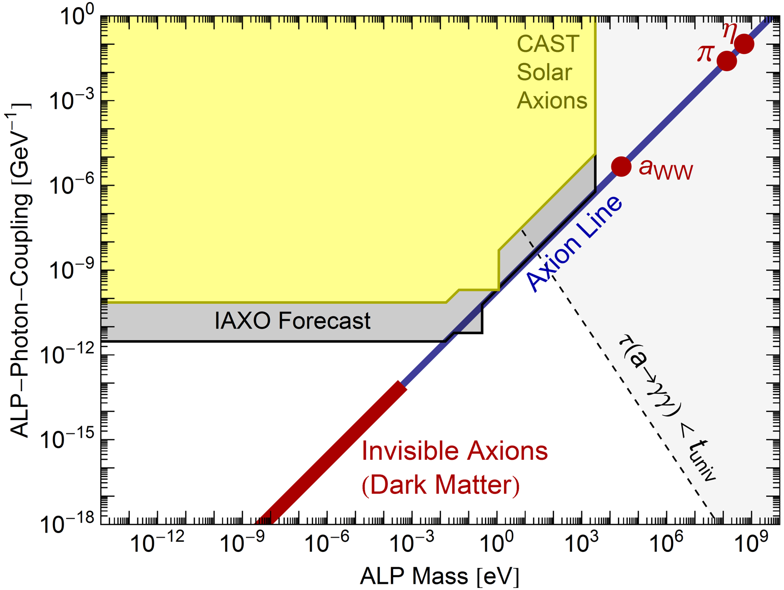
Parameter Space for Axion-Like Particles (ALPs)
- Improvement by
a factor of 30
- Leaping into
uncharted territory
Pushing generic
ALP frontier
QCD Axion
meV frontier

Slide 35
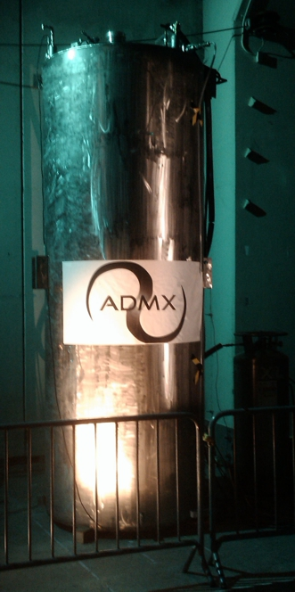
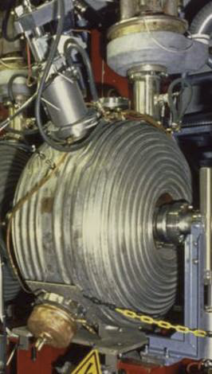
Axion and Axion-Like Particle Searches
ARIADNE
WISP
DMX
(DESY)
Center for Axion & Precision Physics (Daejon, Korea)
MAGIC
ADMX-HF
(Yale)
Axion Dark Matter
Experiment
(UW, Seattle)
H.E.S.S.
IAXO Proposal
(CERN)
CASPEr, perhaps @ HIM (Mainz)
Fermi LAT
CAST @ CERN

Slide 36
Dow Jones Index for Axions: The Rally Continues
inSPIRE: Citation of Peccei-Quinn papers or title axion or axino

