Slide 1
A solution to the Strong CP problem with a softly broken CP symmetry
Pedro Ferreira
ISEL and CFTC, UL
Lisbon, Portugal
Harmonia Meeting, 09/09/2019
P.M. Ferreira and L. Lavoura,
Eur. Phys. J. C (2019) 79:552

Slide 2
THE MODEL
It’s a 2HDM (two SU(2) doublets of hypercharge Y = 1, $Φ_{1}$ and $Φ_{2}$) with an added PECCEI-QUINN-like symmetry – but one that also breaks flavour conservation, acting differently on the several generations.
The LAGRANGIAN has a CP symmetry, which renders all parameters (in the scalar and in the Yukawa sectors) REAL.
Both of those symmetries are SOFTLY BROKEN by a dimension-2 term. This term becomes the only source of CP violation in the model.
A complex CKM matrix is generated; up to (probably) the three loop level, the spin 0 particles of the scalar sector have no CP-violating interactions: they behave like two CP even scalars and a pseudoscalar.
Up to two loops, the strong CP phase is absent from the model.

Slide 3
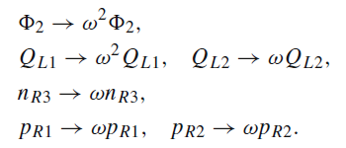
SYMMETRIES OF THE MODEL
The model possesses a CP SYMMETRY, such that all of its parameters are forced to be real.
That is complemented with a Z₃ symmetry which affects both the quark and scalar sectors , such that, with
with ω = e^{2iπ/3}. Recall that n and p and the positive and negative quark fields (not yet rotated to their mass basis) and Γ, Δ are the 3×3 Yukawa coupling matrices, the Yukawa lagrangian being given by
We do not address the leptonic sector in this work – it is easy to see it can be chsen to be flavour conserving, like one of the regular 2HDM types).

Slide 4
SYMMETRIES OF THE MODEL
The Z₃ symmetry BREAKS FLAVOUR CONSERVATION bcause it treats each generation differently. Therefore, tree-level flavour changing neutral currents (FCNC) mediated by scalars are to be expected.
The scalar potential becomes indistinguishable from that of a Peccei-Quinn model,
where we have SOFTLY BROKEN the Z₃ symmetry via the COMPLEX m₁₂ parameter.
The phase θ is the only source of CP violation in the model!
But for the scalar sector, it is easy to think of this phase as vanishing through a doublet phase redefinition – it will turn out later in the fermion sector!

Slide 5
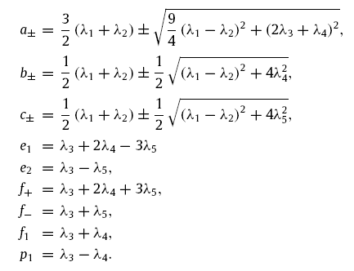
THEORETICAL BOUNDS ON 2HDM SCALAR PARAMETERS
Potential has to be bounded from below:
Theory must respect unitarity:
(for the current model these conditions are valid, with of course λ₅ = 0)

Slide 6
SPONTANEOUS SYMMETRY BREAKING:
Doublet field components:
Both doublets may acquire REAL vevs, v₁ and v₂, such that
Definition of β angle:
(yes, it is unphysical in this model, in principle – call it a placeholder variable...)
Definition of α angle
(h, H: CP-even scalars):
(without loss of generality: -π/2 ≤ α ≤ + π/2)

Slide 7
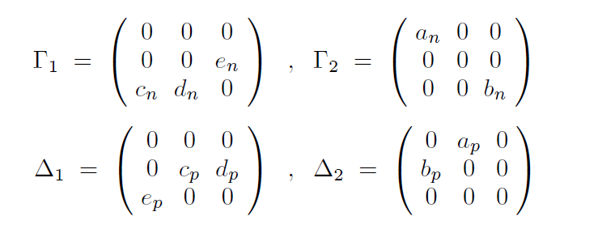
THE YUKAWA SECTOR
The Z₃ symmetry’s impact on the Yukawa matrices is to reduce them to a very simple form (after rephasings),
The quark mass matrices are then REAL and given by
which are bi-diagonalized by matrices U_{L} and U_{R} such that

Slide 8
THE YUKAWA SECTOR
IMPORTANT: the diagonalization matrices end up being REAL ORTHOGONAL matrices,
which has two crucial consequences:
The CKM matrix is given by
V_{CKM} = O_{Lp} × $\left(\begin{matrix}1 & 0 & 0 \\ 0 & \text{e}\text{3}\text{i}\text{θ} & 0 \\ 0 & 0 & \text{e}\text{3}\text{i}\text{θ}\end{matrix}\right)$ × O^{T}_{Ln}
and therefore only through the phase θ does one obtain a complex CKM!
The Yukawa interaction matrices,
are completely REAL in the mass basis:

Slide 9
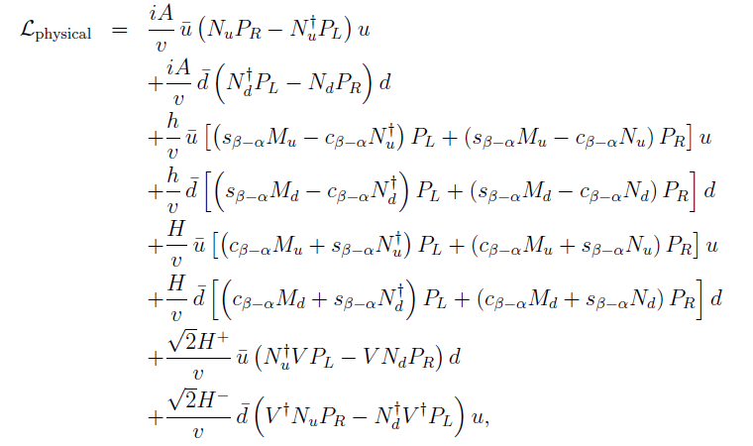
THE YUKAWA SECTOR
But the matrices N_{d} and N_{u} are NOT diagonal in the quark mass basis, due to flavour violation, and therefore we have scalar-mediated tree-level FCNC!

Slide 10
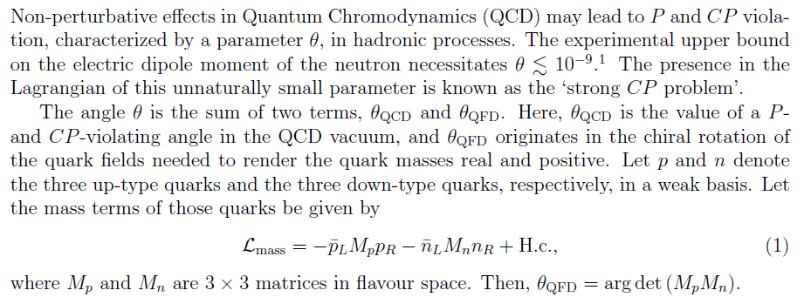
THE STRONG CP PROBLEM
Get rid of θ_{QCD} via the original CP symmetry.
CP symmetry is SOFTLY broken, and complex CKM is obtained!
But mass matrices M_{n} and M_{p} are REAL, therefore, the θ_{QFD} phase usually originating from quark field rephasings is ZERO at tree-level!
Calculation of one-loop quark self-energies show explicitly that this holds at the one-loop level! Presumably also at two-loops...

Slide 11
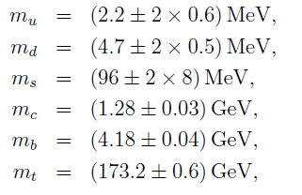
PHENOMENOLOGY
The model has 7 parameters in the scalar sector, and 10 non-zero entries of the Yukawa matrices. It needs to fit the W and Z mass, the observed Higgs boson mass (and SM-like behaviour) and correctly reproduce the quark masses and CKM matrix entries. We took for the quark sector the following values:
The Higgs boson mass was demanded to be equal to 125 GeV, and chosen to be the lighter of the neutral scalars.
The occurrence of FCNC means that a series of mesonic observables wil have to be looked into. Other B-physics constraints, such as b → s γ, will also need to be modified to take into account the neutral scalars’ contributions.

Slide 12
PHENOMENOLOGY
The FCNC interactions of the neutral scalars give tree-level contributions to observables – like neutral meson mass differences (ΔM_{K}, ΔM_{Bs}, ΔM_{Bd}, ΔM_{D}) and ε_{K} – whose leading SM contribution comes at one loop. This will limit the off-diagonal entries of the matrices N_{d} and N_{u} (this last one solely from ΔM_{D}) as well as the masses of the neutral scalars.
Like in the flavour-preserving 2HDM, there are charged Higgs contributions to as b → s γ, but with FCNC the neutral scalars also contribute to this observable. Nonetheless, the charged Higgs contribution is found to be the dominant one.
The charged Higgs is also the main contributor to $Z →b \overline{b}$, although the neutral FCNC contributions were also taken into account.
The parameter space probed could include reasonable low charged and neutral masses, so the possibility of exotic top quark decays ($t →q H^{+}$ or $t →u h, …)$ was also considered, the latest LHC constraints used to limit its possibility

Slide 13
HIGGS ALIGNMENT CUTS
The observed Higgs boson has been found, at the LHC, to behave ina manner quite consistent with SM expectations – so the 2HDM “h” state should be almost aligned with the SM Higgs.
The main experimental observables concerning the 125 GeV scalar are the ratios of observed and expected (in the SM) cross section times branching ratios, for the channels pp → h → XX (with X = ...),
Current uncertainties still allow for non-SM scalars to conform to experimental values. Requiring that μ_{X} does not deviate by more than 20% from 1 (exact SM behaviour) on all channels does an effective description of current experimental constraints.
For a first exploration, only the gluon-gluon fusion cross section was considered. But VBF and other processes would be well described.

Slide 14
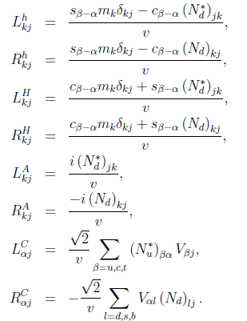
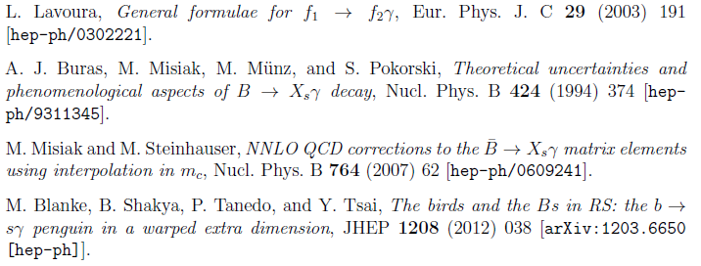
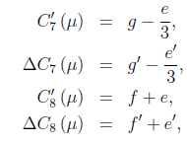
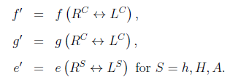
b → s γ EXPRESSIONS
Wilson coefficients:
Conservative cuts in this simplified procedure: require that the calculation yields a branching ratio within twice the error bar of the current experimental result . This has been tested for the “regular 2HDM”, and correctly reproduces the known results for type I and type II models.

Slide 15
ΔM_{K} EXPRESSIONS (SIMILAR FOR OTHER MESONS)
The $K^{0}$ and ${\overline{K}}^{0}$ mesons (s and d bound states) undergo an oscillation procedure and have slightly different masses. The amplitude corresonding to that oscillation has a SM contribution and a New Physics (NP) one, stemming from neutral scalars’ FCNC interactions:
, where
with
and
Large theory uncertainties in this calculation mean we only demand that the New Physics contribution be smaller (in magnitude) than te experimental value

Slide 16
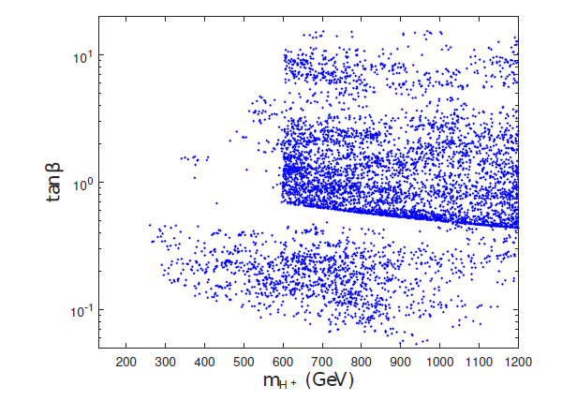
CONSTRAINTS ON CHARGED HIGGS MASS (and tanβ...)
With all theoretical and experimental constraints put into place, a fit on the ~ 17 variables
found was performed and the model allows a valid description of all phenomenology. In the m_{H+} – tanβ plane, those valid parameter space points distribute themselves as:
Main constraints from b → s γ a$nd Z →b \overline{b}$.
Density and distributio of points a consequence of imperfect/incomplete fit.
Different cuts from type I or type II: roughly, .

Slide 17
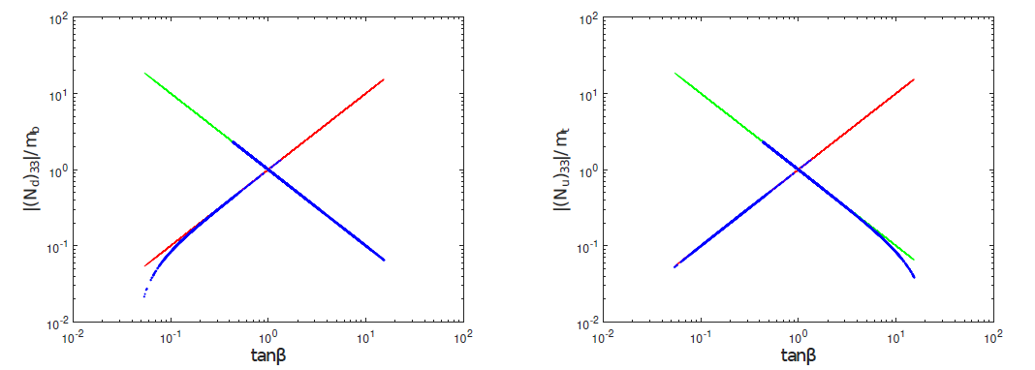
HOW TYPE I/TYPEII-ISH IS THE MODEL?
Unlike flavour-preserving 2HDMs, in this model the up quarks’ masses (particularly the top mass9 can arise both from the Δ₁ and the Δ₂ Yukawa matrices – this yields a “symmetric” restriction on tanβ.
Type I: Type II:
It also yields a “symmetric” behaviour in the Yukawa interaction matrices N_{d} and N_{u} (N_{u} for half of the parameter space, is neither type I nor II!). Other diagonal entries of these matrices deviate a lot from the central type I or type II behaviour, however.
Type II-like
Type I-like
Type I and II-like

Slide 18
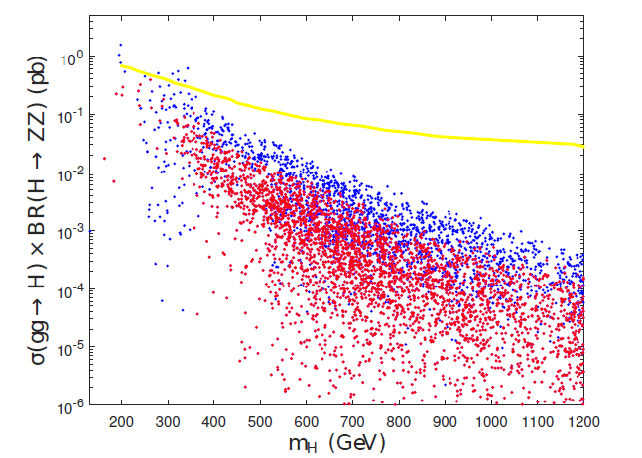
PROPERTIES OF THE EXTRA SCALAR
The heavier CP-even H boson has ZZ decays well below the current experimental limit:
The yellow line is the upper 2σ limit from ATLAS. Blue (red) points have a cut on the Higgs rates μ_{X} of 20% (10%).

Slide 19
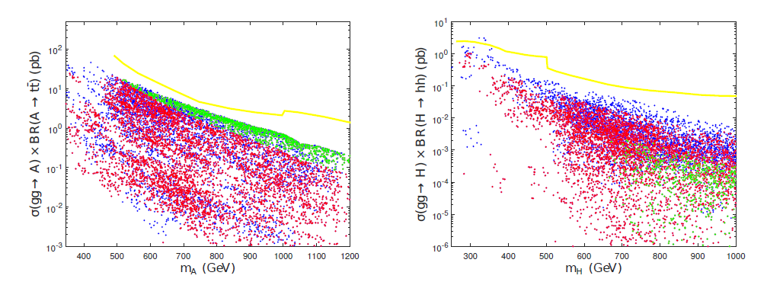
PROPERTIES OF THE EXTRA SCALAR
Likewise for current limits from tt or hh searches.
The yellow line is the upper 2σ limit from ATLAS. Blue (red) points have a cut on the Higgs rates μ_{X} of 20% (10%). The green points are a subset of the red ones, for which the width of the scalar is larger than 10% its mass.

Slide 20
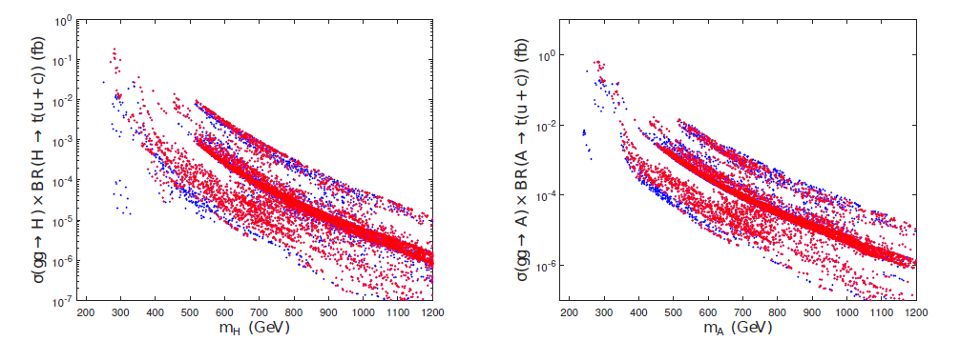
WHAT ABOUT THE FCNC INTERACTIONS?
Demanding that the neutral meson observables comply with experimental results limits the magnitude of the off-diagonal, FCNC, entries of N_{d} and N_{u}.
However, comparatively low masses for the extra scalars are still obtained, without much fine-tuning of those couplings (there are alsocancellations between scalar and pseudoscalar contributions in the meson oscillation parameters).
The 125 GeV Higgs h will have exotic, FCNC decays in this model, such as $h→d \overline{b}$or $h→u \overline{c}$, but in the parameter space found those branching ratios are orders of magnitude below current bounds.
The extra neutral scalars, H and A, will also have FCNC decays, which might yield interesting phenomenology (single top FCNC decays!). However, those decays are also quite constrained.
Blue (red) points have a cut on the Higgs rates μ_{X} of 20% (10%).

Slide 21
CONCLUSIONS
A 2HDM with a flavour-violating Z₃ symmetry yields a solution to the strong CP problem up to 1-loop.
The model has tree-level FCNC scalar interactions, but can describe known theoretical and experimental constrints, particularly the meson mass differences.
The extra scalars predicted by the model may have relatively low masses (~300 GeV) and easily evade current LHC search bounds. But their existence might well be probed in the next LHC run.
FCNC interactions are predicted to be small so as to conform with meson data. New decays of heavier scalars would be a clear sign of their presence, but they are heavily suppressed.

