Slide 1
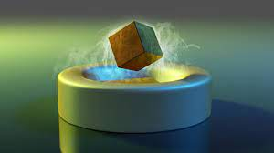
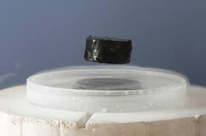
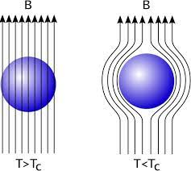
A SUPERCONDUCTING PHASE OF THE N2HDM
Marc Sher
William & Mary
with Arnab Dasgupta and Matthew Knauss

Slide 2
Can U(1)_{EM} be broken during the electroweak phase transition?
The idea is not new:
Dixit and Sher, Phys. Rev. Lett. 68 (1992) 560 -- two doublets + real singlet
Farris, Kephart, Weiler, Yuan, Phys. Rev. Lett. 68 (1992) 564 – one doublet + complex singlet
They wanted to use an intermediate stage of the EWPT to eliminate magnetic monopoles.
Also discussed using the Callan-Rubakov effect to generate a baryon asymmetry

Slide 3
Can U(1)_{EM} be broken during the electroweak phase transition?
The idea is not new:
Dixit and Sher, Phys. Rev. Lett. 68 (1992) 560 -- two doublets + real singlet
Farris, Kephart, Weiler, Yuan, Phys. Rev. Lett. 68 (1992) 564 – one doublet + complex singlet
They wanted to use an intermediate stage of the EWPT to eliminate magnetic monopoles.
Also discussed using the Callan-Rubakov effect to generate a baryon asymmetry
Gates, Krauss, Terning (hep-ph/9203208) showed that the model doesn’t work – not enough
time for the monopoles to find each other. Not much was done after that on U(1) breaking
phases for 15 years.

Slide 4
Ivanov and collaborators studied the phase transitions in 2HDM for a range of
parameters and symmetries and found that there could be a U(1)_{EM} –breaking
phase. Ivanov (0812.4984) and Ginzburg, Ivanov, Kanishev (0911.2383)
They used the high T limit (so transitions tended to be second order). A very
recent paper by Aoki, Biermann, Borschensky, Ivanov, Muhlleitner, Shibuya (2308.04141) used the full finite-temperature potential to show that there was
a small region of parameter space in which the U(1)_{EM}- breaking phase will
occur and the transitions can be first order. See Borschensky’s talk tomorrow.
Our approach will be different – the range of parameter-space will be much
larger and we will study the phenomenological consequences.

Slide 5
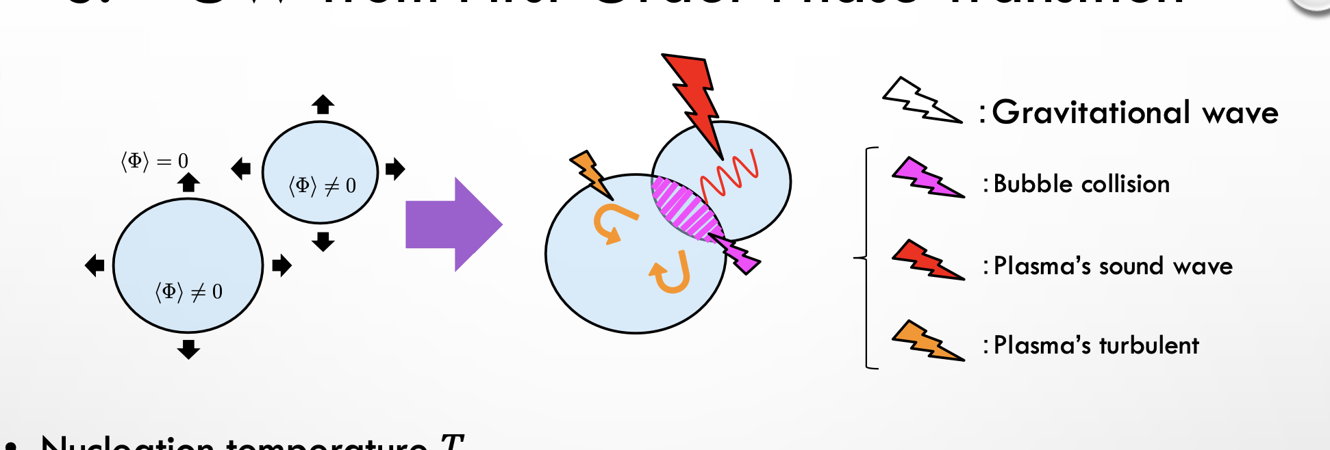
Experimental clues regarding the EWPT:
Electroweak Baryogenesis - Requires a first order transition and CP violation. Standard
Model fails. 2HDMs can work (with higher dimensional operators included)– see
Anisha, Biermann, Englert, Muhlleitner (2204.06966) and see last month’s paper by
Aoki et al. for a detailed discussion and an extensive list of references.
Gravitational wave production from bubble wall collisions –
Also requires a first order transition as shown. A
spectrum of gravitational waves can be detected by
LISA, BBO, DECIGO
Also, the origin of cosmological magnetic fields (see Aoki et al. for references) may be affected.

Slide 6
Electroweak Baryogenesis - Requires a first order transition and CP violation. Standard
Model fails. 2HDMs can work – see Anisha, Biermann, Englert, Muhlleitner (2204.06966)
and see last month’s paper by Aoki et al. for a detailed discussion and an extensive list of
references.
Prefers slow moving bubble walls. (but see next slide)
Gravitational wave production from bubble wall collisions –
Also requires a first order transition as shown.
A spectrum of gravitational waves can be detected by
LISA, BBO, DECIGO
Prefers fast moving bubble walls
Can models exist where both of these can occur in a single step?
Yes. Dorsch et al. (1611.05874) found that there is a VERY narrow range of
parameter space which worked (but recent eEDM results may rule that out - as
noted by Zhao et al (2001.01237))

Slide 7
In 2020, Cline and Kainulainer (2001.00568) showed that a fast moving wall can still
generate a sufficient baryon asymmetry. A nice review is in the TASI Lectures of
Croon (2307.00068) – she distinguishes between deflagration (fluid flow velocity is
smaller than the speed of sound) and detonation (it is greater than the speed of
sound).
Nonetheless, it is still “easier” to generate a sufficient asymmetry if the wall is moving
slowly.
Thus, models which produce both baryogenesis and detectable gravitational radiation
tend to have more than one step.

Slide 8
Thus we consider a multistep transition. Basic idea is
SU(2) x U(1) → no symmetry → U(1)
where gravitational waves are generated in the first transition and EWBG in the second.
In this model, that order is particularly interesting, as we will see.
There are dozens of papers with multi-step EW phase transition. Only a few look at
GW in the first transition and EWBG in the second. The most recent is by
Aoki & Shibuya -2302.11551. There might be too large a sphaleron
suppression in this case – we need to see. If so, the order can be reversed.

Slide 9
The Superconducting phase:
The photon gets a mass -
Two options: v₂ = 0 or v₂ is not =0. If it is nonzero, then the photon is massive and mixes with the W⁺ and W⁻.
This charge violation means that the top and bottom quarks mix, the electron and its neutrino mix (one
combination can be Majorana)
If v₂ = 0, then the photon doesn’t mix with the W’s, but the 9x9 scalar mass matrix does have
Mixing between charged and neutral scalars, which cause top-bottom mixing in any event.
This is an unusual type of EWBG. What does CP violation mean if charge isn’t
conserved? Only need matter-antimatter asymmetry in interactions.

Slide 10
Standard EWBG has massless tops outside the bubbles (so a t_{L} and t_{R}) and
massive tops inside.
Here, if EWBG is at the second step, there are massive states
outside which are combinations of tops and
bottoms and “regular” tops and bottoms inside.
If the EWBG is at the first step, then we have massless tops outside
the bubbles and a massive combination of tops and bottoms inside,
which is interesting.

Slide 11
The N2HDM has two Higgs doublets plus a real singlet. Very detailed analysis
by Muhlleitner, Sampaio, Santos, Wittbrodt (1612.01309, 1703.07550) looked at
the full phenomenology. Their Higgs potential is:
This has an S <-> -S symmetry (no dark matter since S has a vev). We will abandon (or softly break) that
symmetry and add terms:
The last term will be critical to our argument. Repeating the potential only
including the most important terms:

Slide 12
Today, the charged Higgs mass-squared is positive, which means
Basic idea: At high T, m₁², m₂² and μ_{s}² are all positive. As the temperature
drops, m₂² becomes negative and the EW symmetry is broken. If v2=0, then the vev
of S stays zero. If v2 is not equal to zero, then the last term gives a
small vev to the S field (called s₀) due to the linear terms, but μ_{s}² is still positive. However,
the breaking is into the Charge-Breaking vacuum, i.e.
Then the temperature drops further and μ_{s}² changes sign, causing a substantial shift in
the vev of S. Thus there is an interval in which U(1)_{EM} is broken – it could be
substantial if δ₃ is large and μ_{s}²/λ_{s} is small. One just needs (s₀ = 0 in the v₂=0 case)

Slide 13
Current status:
We have found benchmark points (v₂ = 0 case) which satisfy all conditions. This
was yesterday. We’ll get more points and then decide on listing benchmarks or
scatterplots.
Then we study GW production at the first transition. The code is written and works.
Then we study EWBG at the second transition. The code is written and works, but a few
modifications will be necessary.

Slide 14
Future ideas:
Explore origin of cosmological magnetic fields more thoroughly
Look at the 3HDM….

